Slide 1
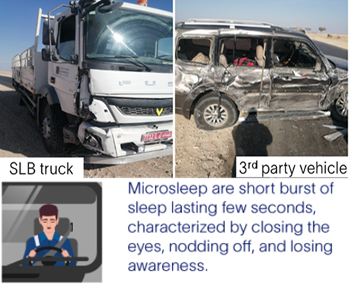
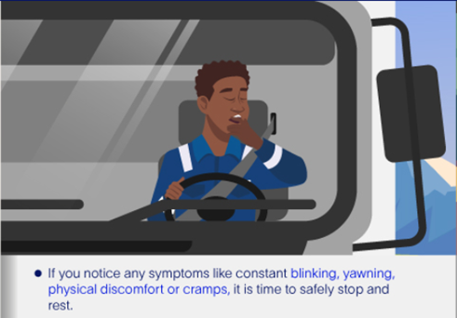
PDO Second Alert
Date: 23/01/2024 Incident title: HiPo#04 Pattern: MVI Potential severity: C4/P Activity: Driving
Target Audience: Drilling, Logistics, Operation & Construction
What happened?
Heavy vehicle HV (Fuso 10 Ton) was performing planned trip from Nizwa to field location. At 2.49 PM while driving with 54 km/hr on single lane blacktop road, HV veered into opposite and involved in right side sideswipe collision with 3rd party vehicle (3 occupant) that was moving on the opposite lane. All people involved in the accident exited the vehicles safely.
Why it happened/Finding :
Restricted ability to maintain driving direction, due impaired awareness to react caused by microsleep stage.
Driver disregarded DFMS in-cab notification and continue driving while fatigued.
Driver may suffer from sleep disorder that can’t be accurately identified during Epworth screening check.
Fatigue Intervention Plan FIP by immediate intervention not established, as IVMS integration not completed.
Your learning from this incident..
Be a safe driver with support from innovative technology, Driver Fatigue Management System DFMS.
Comply with DFMS alerting you of potential risk situations, respect the intervention, stop safely and take rest.
Ensure FIP plan is implemented and Apply FIP by immediate intervention.
Increase awareness among the drivers, on DO’s & DON”Ts regarding DFMS.
Always disclose any health conditions that may affect your & other’s safety.
Always disclose any health conditions that may affect your & other’s safety
Notes:
Ensure all dates and titles are input
A short description should be provided without mentioning names of contractors or individuals. You should include, what happened, to who (by job title) and what injuries this resulted in. Nothing more!
Four to five bullet points highlighting the main findings from the investigation. Remember the target audience is the front line staff so this should be written in simple terms in a way that everyone can understand.
The strap line should be the main point you want to get across
The images should be self explanatory, what went wrong (if you create a reconstruction please ensure you do not put people at risk) and below how it should be done.

Slide 2
Management self audit
Date: 23/01/2024 Incident title: HiPo#04 Pattern: MVI Potential severity: C4/P Activity: Driving
As a learning from this incident and ensure continual improvement all contract managers must review their HSE risk management against the questions asked below
Confirm the following:
Ensure that IVMS integration if DFMS system to establish Fatigue Intervention Plan FIP.
Ensure that real-time intervention is performed part of escalation process.
Ensure that IVMS data & trends are analyzed, to determine potential risk of accumulated fatigue and pro-active corrective action plan is implemented and reviewed.
* If the answer is NO to any of the above questions please ensure you take action to correct this finding
Notes:
Ensure all dates and titles are input
Make a list of closed questions (only ‘yes’ or ‘no’ as an answer) to ask others if they have the same issues based on the management or HSE-MS failings or shortfalls identified in the investigation.
Imagine you have to audit other companies to see if they could have the same issues.
These questions should start with: Do you ensure…………………?

