Slide 1
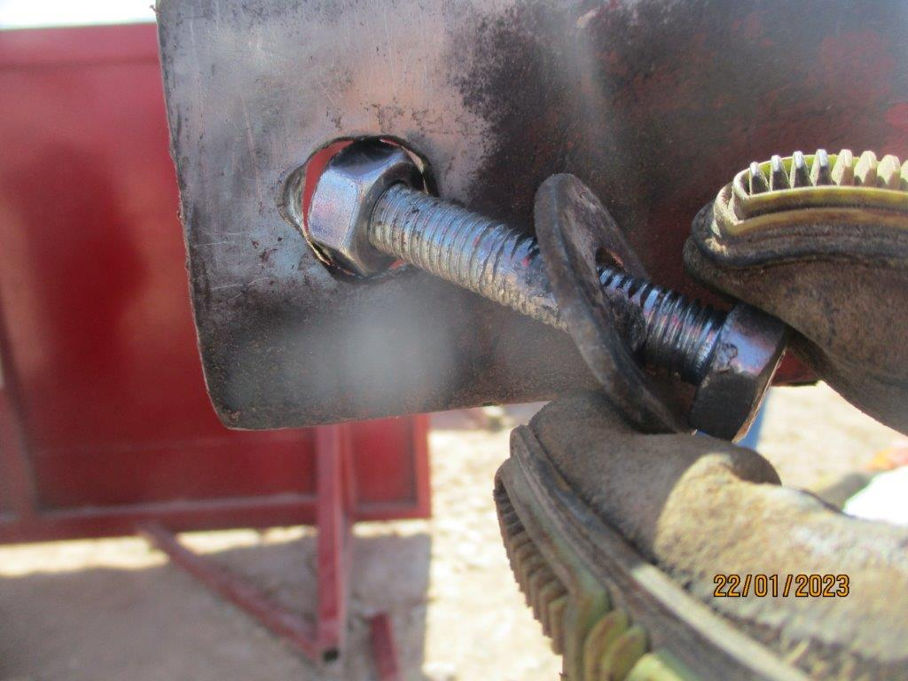
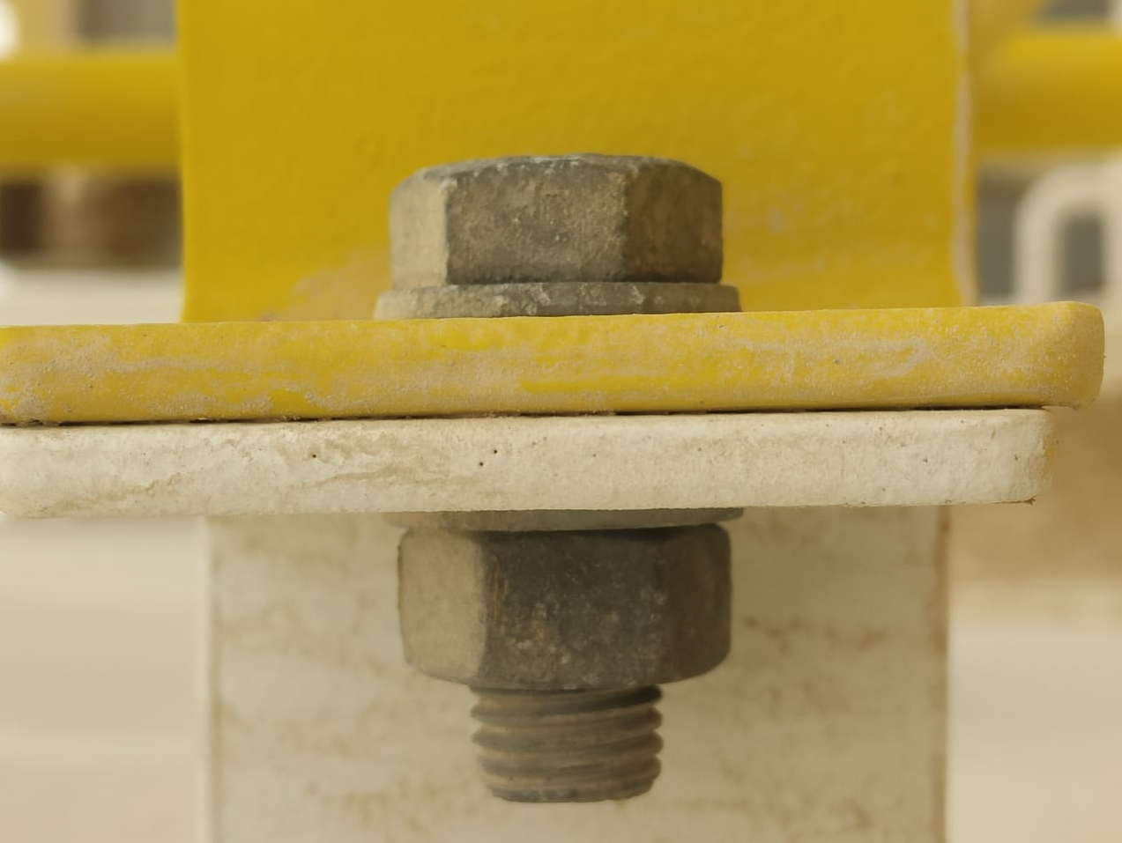
HiPo#04 Rig 38 – Gulf Drilling LLC
PDO Second Alert
Date: 21st Jan 2023 Incident title: HiPo#04 Pattern: Dropped Object Potential severity: C4P
Target Audience: Drivers, Workshop managers
What happened?
On 21st Jan 2023, Third party truck was transporting WC accumulator unit (Koomy) from SARA facility after recertification to Rig-38 to replace the existing accumulator unit on site. On the way near Rima area, the shade frame of Accumulator unit got unbolted and dropped to the side of the road, driver stopped the truck and reported the same to his management.
No Injury.
Why it happened/Finding :
- The shade frame was fixed to the accumulator unit skid with 8 bolts, it was evident that the holes of the skid to put the bolts were gas cut and not in measure.
Shade was not secured as per SP 2001 during transportation. Bolts of the shade attached to accumulator skid was not designed to withstand the wind.
Accumulator skid was rebuilt by the OEM however the shade was not subjected to any periodical maintenance.
Driver has experience however he did not ensure that the load is adequately secured for transportation.
Type of bolts is MM Stainless steel Thread type, Size:1.5 mm, Length: 50 mm, Thickness: 10 mm.
Why it is repeated:
1. Load was not secured properly after inspection ( Failed to learn from previous Incident )
Your learning from this incident.
Always ensure load is secured properly prior starting the journey by nut or web sling.
Always ensure non-OEM equipment are designed to withstand the operational loads.
Always ensure proper securing mechanism is used to secure the loads.
Always ensure frequent check of the load during long journeys.
Always ensure transfer materials secure as per SP 2001
Always ensure structural fabrications are adequately engineered to withstand applicable forces.
Notes:
Ensure all dates and titles are input
A short description should be provided without mentioning names of contractors or individuals. You should include, what happened, to who (by job title) and what injuries this resulted in. Nothing more!
Four to five bullet points highlighting the main findings from the investigation. Remember the target audience is the front line staff so this should be written in simple terms in a way that everyone can understand.
The strap line should be the main point you want to get across
The images should be self explanatory, what went wrong (if you create a reconstruction please ensure you do not put people at risk) and below how it should be done.

Slide 2
Management self audit
Date:21st Jan 2023 Incident title: HiPo#04 Pattern: Dropped Object Potential severity: C4P
As a learning from this incident and ensure continual improvement all contract managers must review their HSE risk management against the questions asked below
Confirm the following:
Do you ensure the add on items of equipment skids are properly designed and risk assessed?
Do you ensure the SJM controls and load safety at the OEM facilities are verified before transportation of equipment’s?
Do you ensure Drivers are considering the load safety prior to the transportation of equipment’s?
Do you ensure the SJM controls at suppliers are verified through audits?
Do you ensure the adequate supervisor arrangements at supplier / OEM facility when equipment required to be transported?
* If the answer is NO to any of the above questions, please ensure you take action to correct this finding
Notes:
Ensure all dates and titles are input
Make a list of closed questions (only ‘yes’ or ‘no’ as an answer) to ask others if they have the same issues based on the management or HSE-MS failings or shortfalls identified in the investigation.
Imagine you have to audit other companies to see if they could have the same issues.
These questions should start with: Do you ensure…………………?

