Slide 1
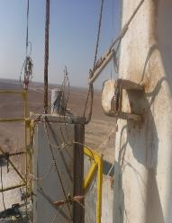
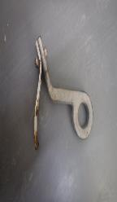
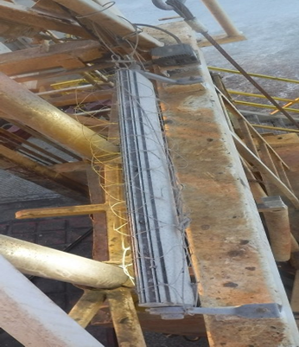
PDO Second Alert
Date:11/01/2022 Incident title: Drop light bracket Pattern: EQD. Potential severity: B4P
What happened?
On 11th Jan 2022 @ 9:45 Am. During milling operation using power swivel with high erratic torque (2000 ft.lb -4000 ft.lb). An abnormal sound heard by the Assistant driller. Operation stopped and while investigating, found a Part of the LED Light bracket holder (Approximate weight : 0.8 kg & Height : 20 meter) at rig floor back side of the manual tong. Red zone was well managed at the time of incident
Why it happened/Finding :
High vibration due to erratic torque while milling operation caused bracket to shear.
The mast light has the primary and secondary retentions in place.
The bracket holding the lights didn’t have any secondary retentions (Welded Part)
Light bracket is not part of yearly inspection, hence corrosion not identified.
Drop object survey (Weekly and two yearly) conducted and valid however hazards of brackets being drop object was not identified.
Different type of light holder grub screws used
Your learning from this incident..
Always ensure brackets holding the lights provided with secondary retention.
Ensure light brackets are inspected yearly (MPI) and included in third party drops survey.
Always conduct visual inspection during high vibration (interval of 6 hours or less)
Always ensure light holder grub screws are standardized and tight.
Ensure red zone is managed all time.
Light of the bracket dropped.
Secondary retention covering light and bracket
Ensure all potential drops are covered with secondary retention
Target Audience: Drilling & Workover
Notes:
Ensure all dates and titles are input
A short description should be provided without mentioning names of contractors or individuals. You should include, what happened, to who (by job title) and what injuries this resulted in. Nothing more!
Four to five bullet points highlighting the main findings from the investigation. Remember the target audience is the front line staff so this should be written in simple terms in a way that everyone can understand.
The strap line should be the main point you want to get across
The images should be self explanatory, what went wrong (if you create a reconstruction please ensure you do not put people at risk) and below how it should be done.

Slide 2
Management self audit
Date:11/01/2022 Incident title: Drop light bracket Pattern: EQD. Potential severity: B4P
As a learning from this incident and ensure continual improvement all contract managers must review their HSE risk management against the questions asked below
Confirm the following:
Do you ensure preventive maintenance is adequately performed?
Do you ensure weekly drop inspection cover light brackets welded parts?
Do you ensure all possible potential DROP provided with secondary retentions?
Do you ensure your PSP include drop survey frequency during vibration/high torque?
Do you ensure 3rd Party bi-yearly drop inspection cover all potential drop points?
* If the answer is NO to any of the above questions please ensure you take action to correct this finding
Notes:
Ensure all dates and titles are input
Make a list of closed questions (only ‘yes’ or ‘no’ as an answer) to ask others if they have the same issues based on the management or HSE-MS failings or shortfalls identified in the investigation.
Imagine you have to audit other companies to see if they could have the same issues.
These questions should start with: Do you ensure…………………?

