Slide 1
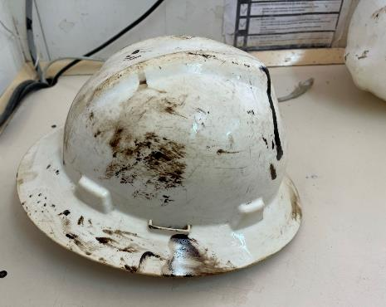
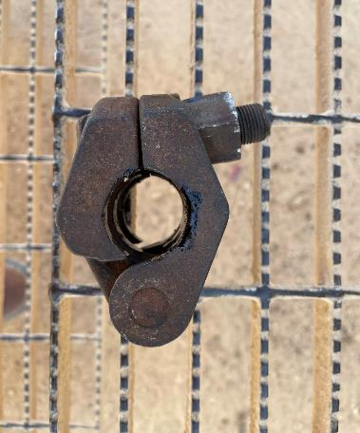

PDO Second Alert
Date: 08.01.2021 Incident: HiPo#04: Dropped object
What happened?
While POOH the 4th tubing joint and picking it up to cut the sucker rod, the tubing pushed the sucker rod clamp out of the string. The string was not secured anymore and slipped 0.5m down. The clamp was resting on the top of the tubing unsecured. While manipulating the joint, the sucker rod clamp slipped from the tubing, hit the elevator and bounced off towards Roustabout striking him on the right side of his helmet and then sliding and hitting him on his shoulder.
Your learning from this incident..
Always follow safe work practices
Always ensure you have a SOP for the task in place, if not check with your supervisor
Always use your STOP WORK AUTHORITY (SWA) if you are unsure of the task
Always ensure the AD is supervised while on the Brake
Always ensure personnel follow Red Zone management
Always ensure the correct clamp is used when pulling sucker rods
Always Stop Work if unsure of the task
Notes:
Ensure all dates and titles are input
A short description should be provided without mentioning names of contractors or individuals. You should include, what happened, to who (by job title) and what injuries this resulted in. Nothing more!
Four to five bullet points highlighting the main findings from the investigation. Remember the target audience is the front line staff so this should be written in simple terms in a way that everyone can understand.
The strap line should be the main point you want to get across
The images should be self explanatory, what went wrong (if you create a reconstruction please ensure you do not put people at risk) and below how it should be done.

Slide 2
Management self audit
Date: 08.01.2021 Incident: HiPo#04: Dropped object
As a learning from this incident and ensure continual improvement all contract
managers must review their HSE HEMP against the questions asked below
Confirm the following:
Do you ensure that learning from incidents are translated into actions and are implemented?
Do you ensure that you have systems in place to verify the competency of the ADs & a system of supervision while they are working at the brake?
Do you ensure the Site leadership team is competent to identify that MOC’s are required in case of changes to operations?
Do you ensure that the wells handover process is being conducted properly?
Do you ensure the CCTV is being properly used to identify safe & at-risk behaviors?
Do you ensure you have a system for ensuring your subcontractors are properly managed & inspected/audited to verify compliance to agreed process & procedures
Do you ensure that personnel on site are wearing the correct color of hard hat for their position or experience
* If the answer is NO to any of the above questions please ensure you take action to correct this finding.
Notes:
Ensure all dates and titles are input
Make a list of closed questions (only ‘yes’ or ‘no’ as an answer) to ask others if they have the same issues based on the management or HSE-MS failings or shortfalls identified in the investigation.
Imagine you have to audit other companies to see if they could have the same issues.
These questions should start with: Do you ensure…………………?

