Slide 1
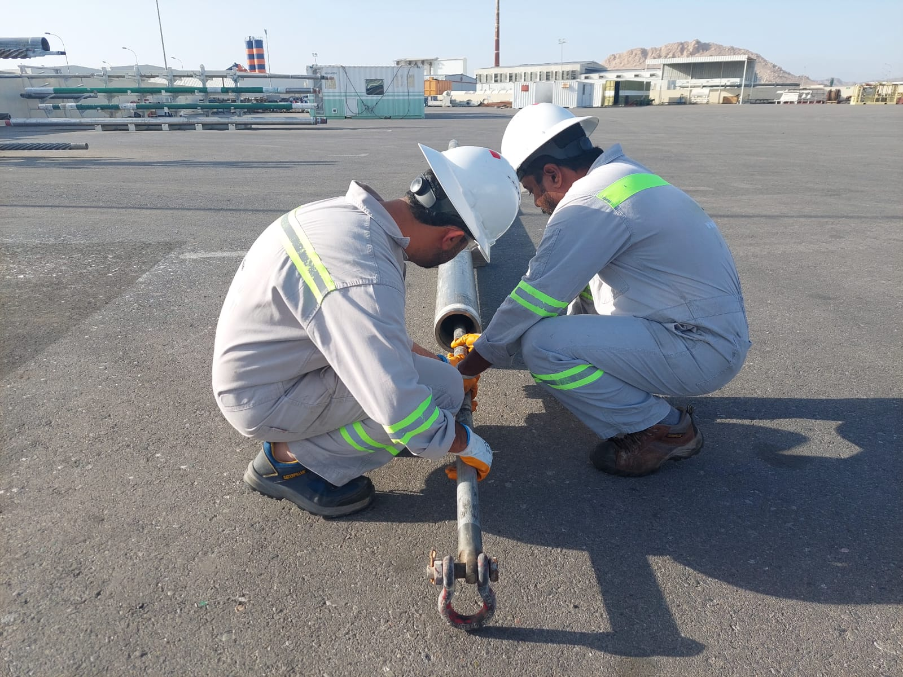
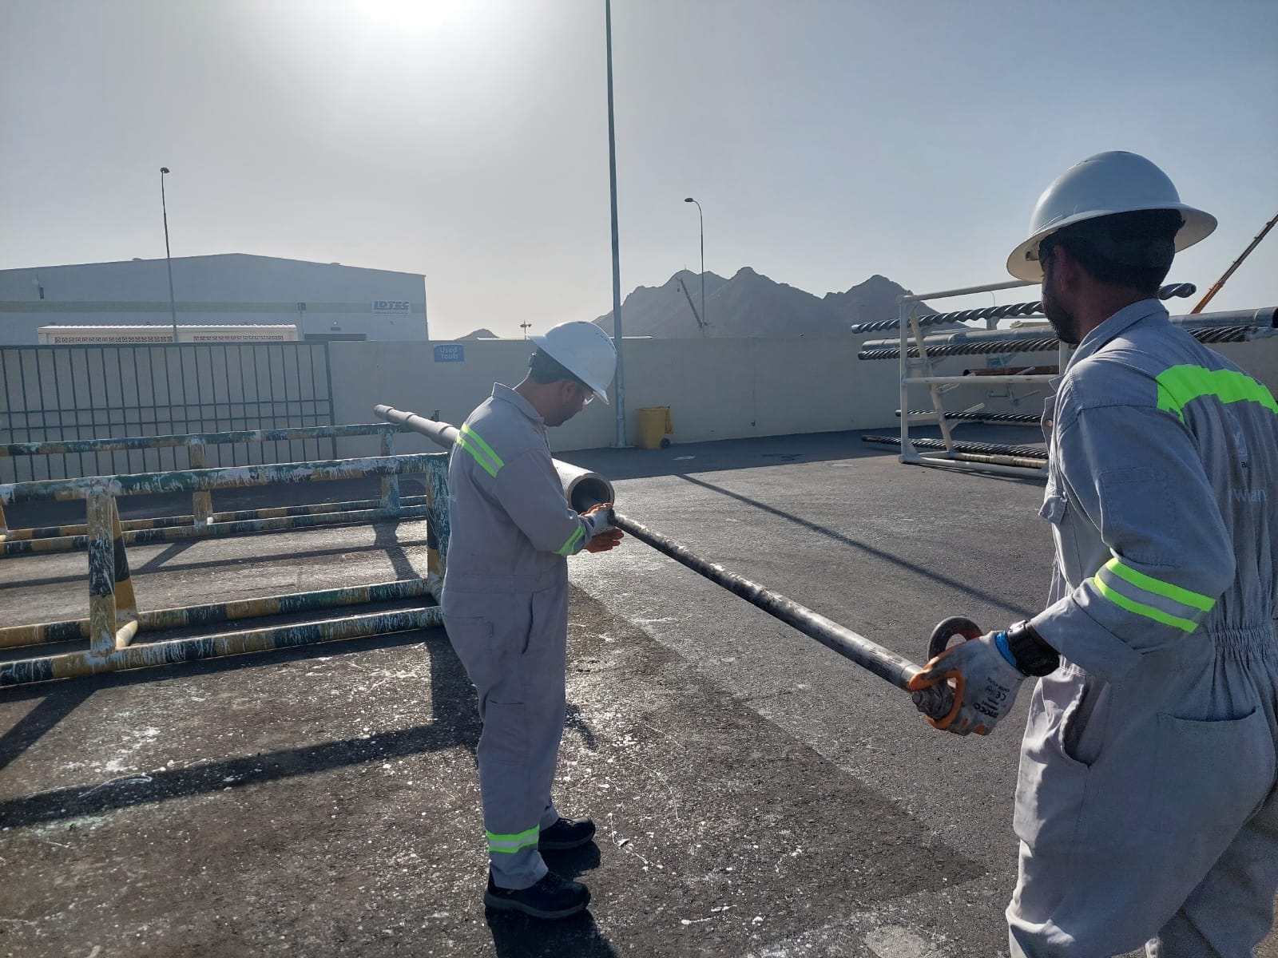
PDO Second Alert
Date:10/02/2024 Incident title: HiPo#05 Pattern: Fire & Explosion Potential severity: C4P Activity: MWD battery exploded inside drill collar
Target Audience: MWD Engineers, Directional Driller, Rig Crews
What happened?
On 10th February 2024 at approx. 7:40 AM, after the 2 MWD Engineers have completed checking and programming the MWD probe (consisted of a pulsar, 2 set of batteries & directional module), together with the Directional Driller (DD) they began to load the probe into the 6 ¾” Non-Magnetic Drill Collar (NMDC) which was placed horizontally on the strip woods on the ground.
Once the probe fish head reached the NMDC shoulder, using the push tool, the DD & MWD Engineer # 2 pushed the probe further until it stopped. MWD Engineer # 1 (IP) went to the pin end of the NMDC to check if the probe seated correctly on the muleshoe. As the probe did not seat inside the muleshoe, the DD started hammering the probe using the push tool when suddenly an explosion occurred. Black powdery smoke from the explosion blew out from both ends of the NMDC, coming in contact with the injured person’s face and right eye. At the time of the incident, the injured MWD Engineer was wearing his safety glasses.
Why it happened/Finding :
Loading the MWD probe on the ground (not on the pipe rack) therefore not giving enough force for sliding the probe inside the NMDC.
Not using lubricant on the probe centralizer therefore creating a friction, making it hard to slide the probe inside the NMDC.
Hammering on the probe using the push tool causing sudden shock on the batteries.
The injured person was standing in front of the pin end of the NMDC i.e. in the line of fire.
The SOP covering this task was non-specific regarding the positioning of the MWD probe height.
Your learning from this incident..
Always stay away from the line of fire
Always ensure to use lubricant on the probe while loading into the collar
Do not create sudden impact on the batteries
Always place the NMDC horizontally on the pipe rack
Always ensure to load the MWD tools with the NMDC on the pipe rack
Notes:
Ensure all dates and titles are input
A short description should be provided without mentioning names of contractors or individuals. You should include, what happened, to who (by job title) and what injuries this resulted in. Nothing more!
Four to five bullet points highlighting the main findings from the investigation. Remember the target audience is the front line staff so this should be written in simple terms in a way that everyone can understand.
The strap line should be the main point you want to get across
The images should be self explanatory, what went wrong (if you create a reconstruction please ensure you do not put people at risk) and below how it should be done.

Slide 2
Management self audit
Date:10/02/2024 Incident title: MWD battery exploded inside drill collar Pattern: Fire & Explosion Potential severity: C4P
As a learning from this incident and ensure continual improvement all contract managers must review their HSE risk management against the questions asked below
Confirm the following:
Do you ensure that loading of the MWD probe is done with the NMDC on the pipe rack?
Do you ensure that employees understand and recognize the line of fire hazards?
Do you ensure that lubricant is used on tools to reduce the friction?
Do you ensure that no sudden impact apply on the batteries?
How do you check the effectiveness of your SOP’s to ensure there is no conflicting information?
* If the answer is NO to any of the above questions please ensure you take action to correct this finding
Notes:
Ensure all dates and titles are input
Make a list of closed questions (only ‘yes’ or ‘no’ as an answer) to ask others if they have the same issues based on the management or HSE-MS failings or shortfalls identified in the investigation.
Imagine you have to audit other companies to see if they could have the same issues.
These questions should start with: Do you ensure…………………?

