Slide 1
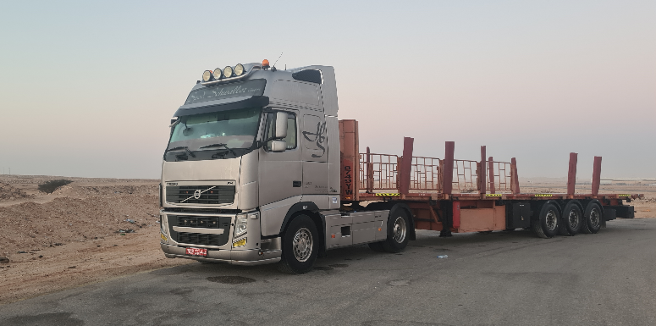


PDO Second Alert
Date: 23.01.2021 Incident title: HiPo#05
What happened?
A man lost was initiated when a driver failed to contact his journey manager. The journey manager was not able to contact the driver or identify his location on IVMS due to no GSM or GPS coverage and not able to contact the delivery location as it did not have a telephone connection. PDO emergency team and ROP were mobilised to search for the driver. Driver was identified the following morning near a Rig (which had not been his planned rest stop) where he had spent the night.
Your learning from this incident..
Drivers
Always ensure you follow your journey plan
Always ensure you use the landline, sat phone etc when delivering to sites with no GSM coverage
Always ensure you ask for help at any local facility when lost
Journey Managers
Always ensure you initiate the man lost procedure as per SP2000
Always ensure drivers are aware of how to contact you when travelling to areas with no GSM coverage
Make every effort to contact JM when required

Slide 2
Management self audit
Date: 23.01.2021 Incident title: HiPo#05
As a learning from this incident and ensure continual improvement all contract
managers must review their HSE HEMP against the questions asked below
Confirm the following:
Do you ensure drivers have been briefed to use delivery location landline phone / sat phone etc if delivering to location without GSM coverage?
Do your Journey Managers know locations which do not have GSM / GPS coverage?
Do your Journey Managers brief known GSM / GPS dead locations to drivers?
Do you ensure man lost procedures are understood and followed by Journey Managers?
Do you ensure all visitors to your site are signed in and accounted for at Rigs and Camps?
Do you ensure drivers are aware of the route to their destination?
* If the answer is NO to any of the above questions please ensure you take action to correct this finding.
Notes:
Ensure all dates and titles are input
Make a list of closed questions (only ‘yes’ or ‘no’ as an answer) to ask others if they have the same issues based on the management or HSE-MS failings or shortfalls identified in the investigation.
Imagine you have to audit other companies to see if they could have the same issues.
These questions should start with: Do you ensure…………………?

