Slide 1
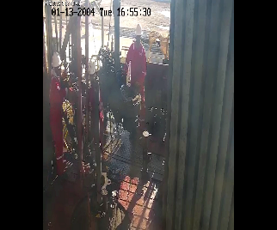
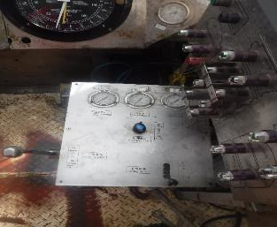
PDO Second Alert
Date:15-01-2022 Incident title: Travelling Block descend Pattern: NM. Potential severity: C4P
What happened?
On 15th January 2022 at 9:03 AM. While pulling out fishing assembly and at the last joint of 4.3/4" drill collar, Driller picked the traveling block to approximately 3 meters height and activated the parking brake. Floor hands were tie-back manual tong and prepare for next operation, the traveling block start to descend until the elevator reached the rig floor and floor saver activated. No injuries or equipment damage.
Why it happened/Finding :
Driller applied parking brake and confirmed pressure was zero then moved away from drillers panel.
Driller and floor hands did not notice that the traveling block descending.
Internal leak on the directional valve resulted to release the parking brake.
Floor saver activated with delay.
You're learning from this incident..
Operator shall apply emergency brake any time operation is stopped.
Operator should focus on crew and equipment while people working in red zone.
PMS (Work order) should cover the servicing/change out of air operated braking system directional valve on driller consol.
Emergency brake
Parking brake
Operator shall apply emergency brake any time operation is stopped.
Apply both parking & emergency break together
.
Target Audience: Drilling and Workover
Notes:
Ensure all dates and titles are input
A short description should be provided without mentioning names of contractors or individuals. You should include, what happened, to who (by job title) and what injuries this resulted in. Nothing more!
Four to five bullet points highlighting the main findings from the investigation. Remember the target audience is the front line staff so this should be written in simple terms in a way that everyone can understand.
The strap line should be the main point you want to get across
The images should be self explanatory, what went wrong (if you create a reconstruction please ensure you do not put people at risk) and below how it should be done.

Slide 2
Management self audit
Date:15-01-2022 Incident title: Uncontrolled descend Pattern: NM. Potential severity: C4P
As a learning from this incident and ensure continual improvement all contract managers must review their HSE risk management against the questions asked below
Confirm the following:
Do you ensured parking brake / emergency brake are engaged?
Do you ensure proper adjusting of floor saver in different scenarios?
Do you ensure your operators have clear run-away procedure?
Do you ensure unit manager is available at rig floor during BHA operation?
Do you ensure floor saver is set properly and tested at start of each shift?
* If the answer is NO to any of the above questions please ensure you take action to correct this finding
Notes:
Ensure all dates and titles are input
Make a list of closed questions (only ‘yes’ or ‘no’ as an answer) to ask others if they have the same issues based on the management or HSE-MS failings or shortfalls identified in the investigation.
Imagine you have to audit other companies to see if they could have the same issues.
These questions should start with: Do you ensure…………………?

