Slide 1
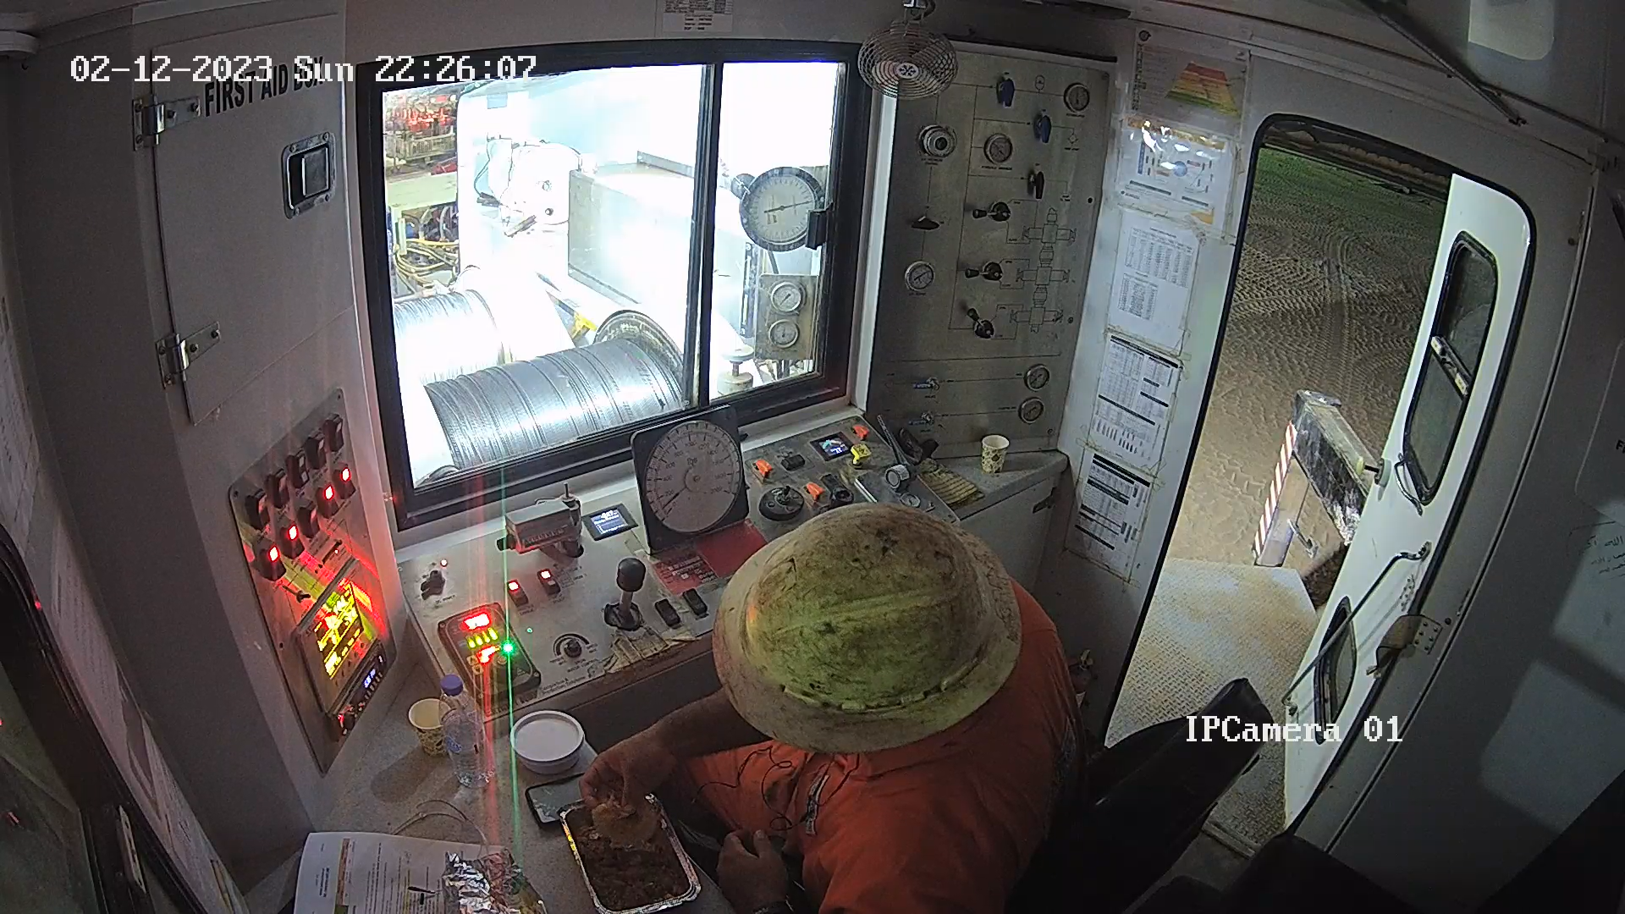
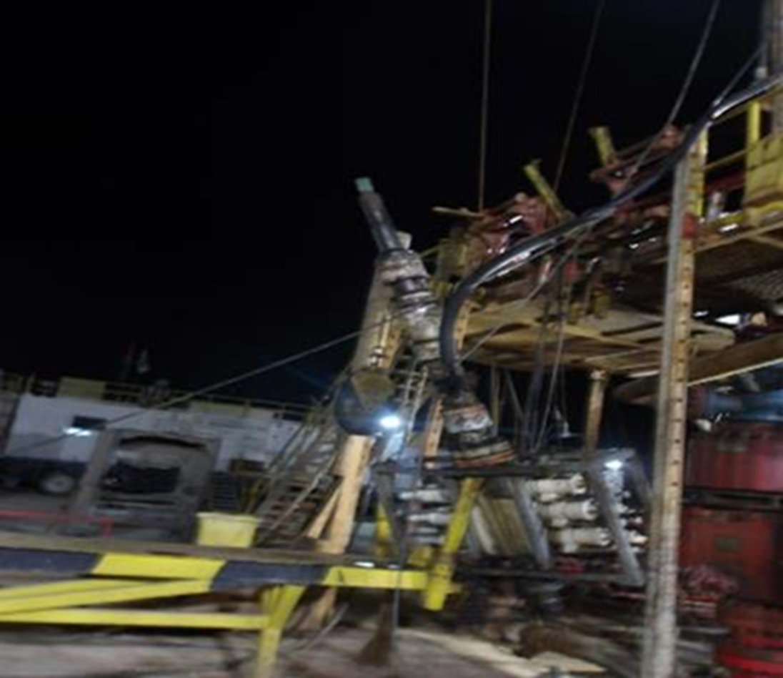
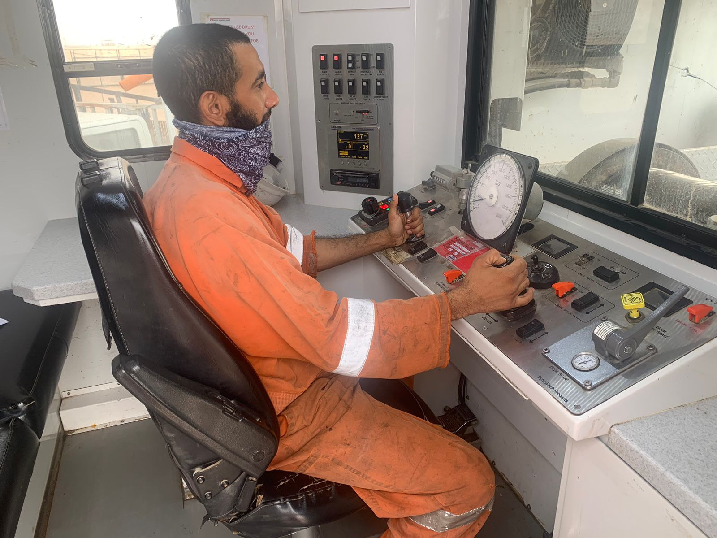
PDO Second Alert
Date: 12.02.2023 Incident title: HiPo# 06 Pattern: LOF/Drops Potential severity: C4P Activity: Slickline
Target Audience: Rigs & Hoists – Slick line contractors
Unsafe Condition
What happened?
On 12th February 2023 at 22:30 hours, operation was shifting completion barriers by Hadco slick line. While preparing for fifth slick line run and while attempting to connect the lubricator to slick line BOP stack, suddenly the complete slick line BOP tilted toward V-door side. This has resulted in disconnection of 2”3/8 NU coupling and causing the complete slickline BOP to drop from rig floor and to rest on V-door frame from a height of 3m. At the same time, the slickline wire got parted resulting in the fall of slickline tool which penetrated through driller cabin top roof window. No injury was reported and minor equipment damage.
Why it happened/Findings:
TBT,PTW and generic JSA in place but without task-based risk assessment for the lubricator lift
SL BOP was pulled sideways with 1,000lbs unintended tension on the slickline during the lubricator lifting because SL Operator did not follow SOP to slack the wire before the lift
BOP assembly subsequently got disconnected from the threaded 2 3/8” tubing end due to the sideways wire tension
BOP fell to the V-door and the slickline tool dropped from the lubricator, landing on the roof of the driller cabin
SL Operator was not focused on his job, taking a meal break inside cabin while lifting was in progress
Slickline assistant who was on the BOP work platform at the time of incident was saved by the safety harness from falling from height
No further harm due to well managed No-Go zone with rigid barriers
Driller & AD were in driller’s cabin at the time of incident
Your learning from this incident.
Always use the correct size/capacity of equipment.
Always stay away from the line of fire.
Always follow SOP and maintain focus on the job at hand.
Always execute SWA for any unsafe act or unsafe condition.
Safe Condition
Always stay away from the line of fire and stay focused on the job at hand.
Notes:
Ensure all dates and titles are input
A short description should be provided without mentioning names of contractors or individuals. You should include, what happened, to who (by job title) and what injuries this resulted in. Nothing more!
Four to five bullet points highlighting the main findings from the investigation. Remember the target audience is the front line staff so this should be written in simple terms in a way that everyone can understand.
The strap line should be the main point you want to get across
The images should be self explanatory, what went wrong (if you create a reconstruction please ensure you do not put people at risk) and below how it should be done.

Slide 2
Management self audit
Date: 12.02.2023 Incident title: HiPo# 06 Pattern: LOF/Drops Potential severity: C4P Activity: Slickline
As a learning from this incident and ensure continual improvement all contract managers must review their HSE risk management against the questions asked below
Confirm the following:
Do you ensure that site team adhere to zone management procedure
Do you ensure that your SOP and JSA cover all hazards and risks related to operation ?
Do you ensure that enough controls are in place prior to perform any critical task?
* If the answer is NO to any of the above questions please ensure you take action to correct this finding
Notes:
Ensure all dates and titles are input
Make a list of closed questions (only ‘yes’ or ‘no’ as an answer) to ask others if they have the same issues based on the management or HSE-MS failings or shortfalls identified in the investigation.
Imagine you have to audit other companies to see if they could have the same issues.
These questions should start with: Do you ensure…………………?

