Slide 1
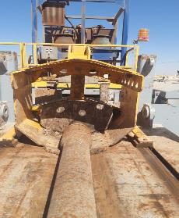
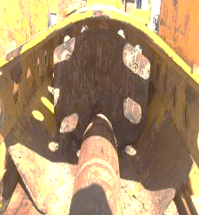
PDO Second Alert
Date:20/01/2022 Incident title: HiPo#08 Pattern: Drops Potential severity: C4P
Target Audience: Driller, Assistant driller, Floor hands
What happened?
while laying down 4” Drill Pipe singles, using Pipe-Cat (hydraulic catwalk system), BX Hydraulic elevator & Top drive. After lowering the drill pipe joint on the pipe cat trough and adjust the skate, Driller unlatch the BX elevator and lower it down. Once drill pipe joint released from elevator, it came out of skate hood opening and slide all the way down to ground and rested on pipe racks. Red zone was fully implemented. No injury and no damages
Why it happened/Finding :
Red zone and No-Go zone management was fully implemented (verified by CCTV).
Skate hood was not adjusted to accommodate 4” Drill Pipe.
The adjustment of skate hood details mentioned in DOP but not discussed in TBT and JSA.
Driller and Floor hands trained for operating pipe cat
Driller failed to identify the elevator is not fully opened before lowering it on this specific joint
Your learning from this incident..
Ensure to adjust pipe cat skate hood height before each trip to accommodated tubular size.
Ensure to release the elevators only when the tubular is completely supported by the trough
Always refer DOP to refresh job steps.
Maintain No-Go zone below catwalk at all times while operating pipe cat
Install Hard barrier on pipe cat skate on all units to avoid any potential drop.
Adjust pipe cat skate hood height according to tubular size in use
Notes:
Ensure all dates and titles are input
A short description should be provided without mentioning names of contractors or individuals. You should include, what happened, to who (by job title) and what injuries this resulted in. Nothing more!
Four to five bullet points highlighting the main findings from the investigation. Remember the target audience is the front line staff so this should be written in simple terms in a way that everyone can understand.
The strap line should be the main point you want to get across
The images should be self explanatory, what went wrong (if you create a reconstruction please ensure you do not put people at risk) and below how it should be done.

Slide 2
Management self audit
Date: 20/01/2022 Incident title: HiPo#08 Pattern: Drops Potential severity: C4P
As a learning from this incident and ensure continual improvement all contract managers must review their HSE risk management against the questions asked below
Confirm the following:
- Do you ensure that your JSA covered all hazards and risks related to operating pipe cat?
- Do you ensure having enough control points prior performing any critical task?
- Do you ensure the adequacy of training programs and competency assessment ?
- Do you ensure incident learning are retrieved and implemented from similar mechanized rigs?
* If the answer is NO to any of the above questions please ensure you take action to correct this finding
Notes:
Ensure all dates and titles are input
Make a list of closed questions (only ‘yes’ or ‘no’ as an answer) to ask others if they have the same issues based on the management or HSE-MS failings or shortfalls identified in the investigation.
Imagine you have to audit other companies to see if they could have the same issues.
These questions should start with: Do you ensure…………………?

