Slide 1
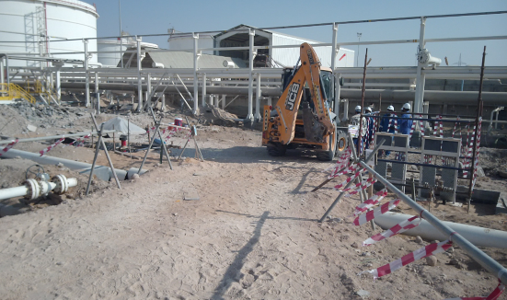
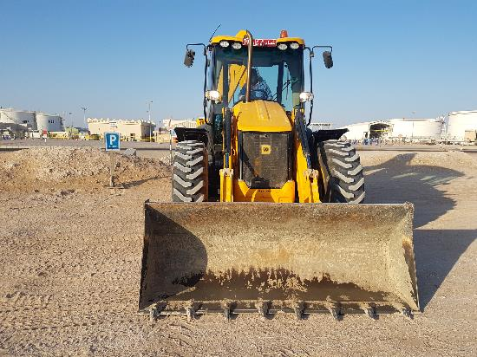
PDO Second Alert
Date:07.02.2021 Incident type: HiPO#11
What happened?
A backhoe loader operator turned off the engine while in motion after entering access road approaching the worksite. On his way, he realised that the pedal brake of the equipment became ineffective. He waved hand to alert the crew being assembled for TBT, and applied hand brake to stop the equipment. However, backhoe bucket slowly came in contact with three employees leading to minor abrasion on their legs. Investigation revealed that the pedal brake was ineffective due to failure of the accumulator under engine off condition.
Your learning from this incident..
Always ensure that the equipment is not brought inside the live facility unless it is required to carry the specified task.
Always park the equipment at the designated parking place.
Always ensure that the engine is not switched off while the equipment is in motion / operation.
Always check and pay attention to the warning signs appearing on the dashboard and do not use the equipment until the defects are rectified.
Always select a safe location for conducting TBT away from hazards like Line of Fire.
Always ensure full compliance with the vehicle access permit – Permit Holder to accompany the equipment all time when it is in the station.
Always check the equipment warnings signs and rectify defects, if any.
Notes:
Ensure all dates and titles are input
A short description should be provided without mentioning names of contractors or individuals. You should include, what happened, to who (by job title) and what injuries this resulted in. Nothing more!
Four to five bullet points highlighting the main findings from the investigation. Remember the target audience is the front line staff so this should be written in simple terms in a way that everyone can understand.
The strap line should be the main point you want to get across
The images should be self explanatory, what went wrong (if you create a reconstruction please ensure you do not put people at risk) and below how it should be done.

Slide 2
Management self audit
Date:07.02.2021 Incident type: HiPO#11
As a learning from this incident and ensure continual improvement all contract
managers must review their HSE HEMP against the questions asked below
Confirm the following:
Do you ensure designated parking areas for all construction Equipment are allotted & Risk assessment carried out?
Do you ensure the Operators have access to and they follow the OEM procedures?
Do you ensure Competency of the Operators?
Do you ensure construction equipment are well maintained and free of fault?
Do your ensure implementation of LFIs are verified?
Do you ensure full compliance with conditions specified in Permit and vehicle access authorization?
* If the answer is NO to any of the above questions please ensure you take action to correct this finding.
Notes:
Ensure all dates and titles are input
Make a list of closed questions (only ‘yes’ or ‘no’ as an answer) to ask others if they have the same issues based on the management or HSE-MS failings or shortfalls identified in the investigation.
Imagine you have to audit other companies to see if they could have the same issues.
These questions should start with: Do you ensure…………………?

