Slide 1
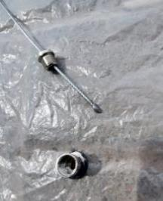
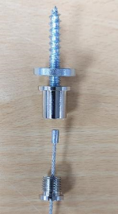
PDO Second Alert
Date:05/03/2023 Incident title: HiPo#12 Pattern: Drops. Potential severity: B4P Activity: installation of acoustic panels
Target Audience: Drilling, Logistics, Operation & Construction
What happened?
Why it happened/Finding :
OEM supplied wire hangers were not used.
Inappropriate QA/ QC checks carried out.
Your learning from this incident..
Only use the OEM supplied parts.
QA/QC checks to ensure correct materials are delivered and used.
QA/QC resource to be re-evaluated
Do not improvise to get the work completed.
Designer to be appointed to coordinate the design.
An enhancement was undertaken in the BMF atrium and part of this work was to install acoustic ceiling panels. On the 05.03.23 one of the acoustic panels, weighing approximately 4.5 Kg fell from its installed position (approximately 12. 5 meters height) to the ground at BMF Atrium. No people were injured. The fixing wire end cap / stopper failed at the point of connection to the ceiling fixing point due to poor quality of materials, causing the panel to fall to the ground
Quality - Do it right the first time
Notes:
Ensure all dates and titles are input
A short description should be provided without mentioning names of contractors or individuals. You should include, what happened, to who (by job title) and what injuries this resulted in. Nothing more!
Four to five bullet points highlighting the main findings from the investigation. Remember the target audience is the front line staff so this should be written in simple terms in a way that everyone can understand.
The strap line should be the main point you want to get across
The images should be self explanatory, what went wrong (if you create a reconstruction please ensure you do not put people at risk) and below how it should be done.

Slide 2
Management self audit
Date:05/03/2023 Incident title: HiPo#12 Pattern: Drops. Potential severity: B4P Activity: installation of acoustic panels
Confirm the following:
Do you ensure that the product and installation is a per design specification?
Do you ensure quality assurance check on your supplier's materials and work?
Do you ensure supplied products are OEM or to the same specification and used correctly?
Do you follow Management of change process and ensure the changes are correctly communicated ?
Do you ensure that the agreed ITP check sheets are completed by a competent person during your construction period?
* If the answer is NO to any of the above questions please ensure you take action to correct this finding
Notes:
Ensure all dates and titles are input
Make a list of closed questions (only ‘yes’ or ‘no’ as an answer) to ask others if they have the same issues based on the management or HSE-MS failings or shortfalls identified in the investigation.
Imagine you have to audit other companies to see if they could have the same issues.
These questions should start with: Do you ensure…………………?

