Slide 1
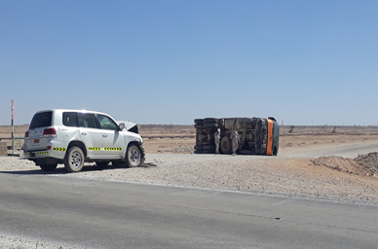
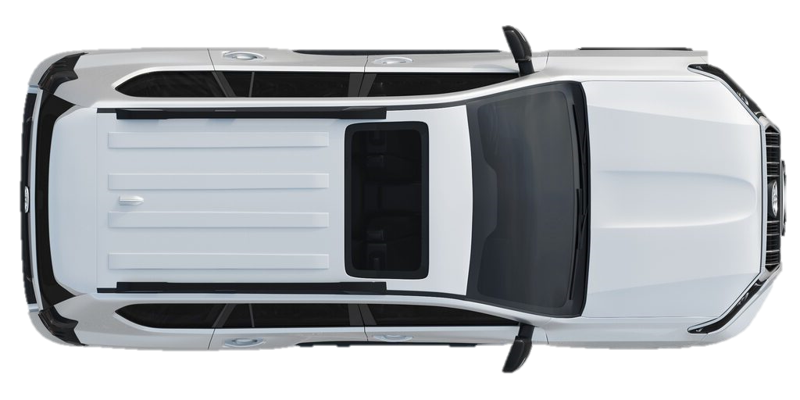
PDO Second Alert
Date: 09/02/2022 Incident title: HiPo #12 Pattern: MVI Potential severity: C4P
Target Audience: All
What happened?
A Tipper travelling from Al Burj to Saqr while crossing Shaleem blacktop road was hit on right rear
side by an approaching land cruiser. Impact resulted in tip over of the tipper to the left. Tipper driver
sustained minor injuries. Both drivers shifted to clinic for medical management. Informed to PDO
Emergency No, RSST and ROP.
Why it happened/Finding :
Direct immediate and underlying causes. Add essential information only with a direct link to incident.
Tipper driver crossed the road without stopping at the junction, at an inappropriate speed.
Land Cruiser Driver while driving was concentrating on rig sign boards at the right side of blacktop road for his next day’s job.
LFI from previous incidents were not followed.
Coaching conducted for previous continuous driving violations were not effective
Your learning from this incident..
(This must solely relate to the people at risk of harm or people at risk of causing the harm)
Learning points for them from the investigation
Always stop, look and then proceed before entering the junction
Always reduce speed while heading the junction
Always stop at intersection before entering black top road from graded road.
Always follow defensive driving techniques while on road
Always recognize and respond to dynamic/immediate risks
Always encourage drivers to report the road conditions and damaged road signs to concerned authority
Stop, look and proceed before crossing the road intersection
Notes:
Ensure all dates and titles are input
A short description should be provided without mentioning names of contractors or individuals. You should include, what happened, to who (by job title) and what injuries this resulted in. Nothing more!
Four to five bullet points highlighting the main findings from the investigation. Remember the target audience is the front line staff so this should be written in simple terms in a way that everyone can understand.
The strap line should be the main point you want to get across
The images should be self explanatory, what went wrong (if you create a reconstruction please ensure you do not put people at risk) and below how it should be done.

Slide 2
PDO Second Alert
Date: 09/02/2022 Incident title: HiPo #12 Pattern: MVI Potential severity: C4P
As a learning from this incident and ensure continual improvement all contract managers must review their HSE risk management against the questions asked below
Confirm the following:
Do you ensure that your drivers are following learning from incidents?
Do you ensure that all the road related behavioral deviations are reported?
Do you ensure that all drivers have attended commentary drive assessment?
Do you ensure that your drivers are stopping the vehicle at all junctions?
Do you ensure your drivers are following all road signs while driving?
Do you ensure your drivers are following defensive driving technique?
Do you ensure consequence management is applied for all violations reported?
Do you ensure all parameters are monitored through IVMS and corrective action taken on deviations observed?
* If the answer is NO to any of the above questions please ensure you take action to correct this finding
Notes:
Ensure all dates and titles are input
Make a list of closed questions (only ‘yes’ or ‘no’ as an answer) to ask others if they have the same issues based on the management or HSE-MS failings or shortfalls identified in the investigation.
Imagine you have to audit other companies to see if they could have the same issues.
These questions should start with: Do you ensure…………………?

