Slide 1
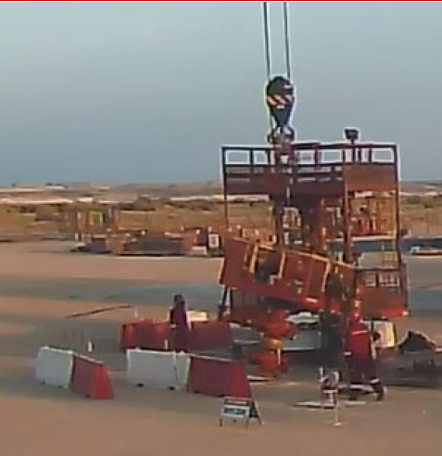
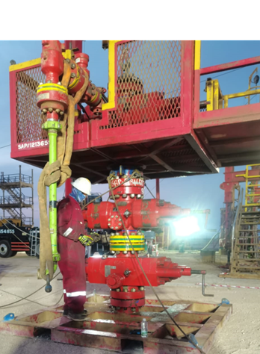
PDO Second Alert
Date:10/03/2023 Incident title: HiPo#13 Pattern: FAC Potential severity: B4P Activity: Rig Up HWO
Target Audience: Drilling, Logistics, Operation & Construction
was done wrong
What happened?
HWO rig up was in progress at well MAS-01 around 0500hrs crew picked up the stripping stack with the 130T crane and lifted the stripping stack on top of BOP#3. Day shift crew completed safety meetings and handover and jack operator identified that BOP#3 was only supported by a wooden plate, Stop Work Authority was used but not communicated with the supervisor, crew decided to move the BOP on to the correct BOP stand. While preparing the BOP to be repositioned It was found that the torque wrench was stuck on one of the nuts under the BOP. Lead hand went under to free the torque wrench and at that time the wooden plate broke causing the load weight to settle in the crane. Lead hand hit his hand on the XT while evacuating the area, Medic checked and found ok.
Halliburton Crew Stopped the operation and informed PDO DSV.
Why it happened/Finding :
Inefficient site supervision onsite.
Permit issued without walking the line / daily hazard hunt
Shortcut to not use the correct equipment
Ineffective use of Stop Work Authority
Your learning from this incident..
Always ensure to use the correct equipment for the task in hand.
Prior to issue Permit to Work site leader's are to walk the line and perform hazard hunt.
Any Stop Work Authority shall be communicated to the well site leaders.
Lift plans & JSA’s are to the relevant to the task in hand.
Always take the time on location to perform the correct job assessments for the task in hand.
Short cuts never save time
Notes:
Ensure all dates and titles are input
A short description should be provided without mentioning names of contractors or individuals. You should include, what happened, to who (by job title) and what injuries this resulted in. Nothing more!
Four to five bullet points highlighting the main findings from the investigation. Remember the target audience is the front line staff so this should be written in simple terms in a way that everyone can understand.
The strap line should be the main point you want to get across
The images should be self explanatory, what went wrong (if you create a reconstruction please ensure you do not put people at risk) and below how it should be done.

Slide 2
Management self audit
Date:10/03/2023 Incident title: FAC Pattern: FAC Potential severity B4P Activity:. Rig Up HWO Unit
As a learning from this incident and ensure continual improvement all contract managers must review their HSE risk management against the questions asked below
Confirm the following:
- Do you ensure that the right equipment is used for task onsite.
- Do you ensure that effective supervision is available at all time onsite.
- Do you ensure that frequent discussions are held periodically with the team for every task.
- Do you ensure that lifting plans and Job Safety Analysis are the adequate for task in hand.
- Do you ensure that the implementation of Stop Work Authority is effective on your site location.
* If the answer is NO to any of the above questions please ensure you take action to correct this finding
Notes:
Ensure all dates and titles are input
Make a list of closed questions (only ‘yes’ or ‘no’ as an answer) to ask others if they have the same issues based on the management or HSE-MS failings or shortfalls identified in the investigation.
Imagine you have to audit other companies to see if they could have the same issues.
These questions should start with: Do you ensure…………………?

