Slide 1
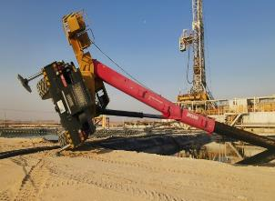
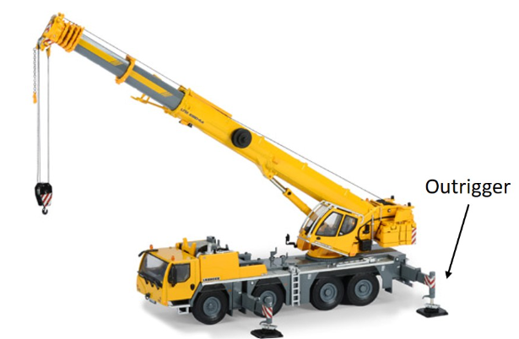
PDO Second Alert
Date:12/03/2023 Incident title: HIPO Pattern: Tipped over Potential severity: C4P Activity: Lifting Operation
Target Audience: Crane Operator/Banks Man/Rigger/LEC/Lifting Supervisor/Appointed person
What happened?
At 3:10am, the mobile crane was in the process of transferring a submersible pump from cutting pit to water pit. The
pump was lifted from the water pit, transferred to the cutting pit and began to hoist down. Once the pump touched
the bottom, the crane fell over and the boom landed in the pit. The crane outriggers were not extended during this
job .
Why it happened/Finding:
Team did not use JSA ,TRIC and routine lifting plan prior to task.
The 10 questions for safe lifting operation & 7 steps technique from the team was not applied.
There was no TBT conducted prior the lift is being conducted
No PTW Was issued for the job
There was no lifting supervisor along with the lift.
Crane operator did not extend the crane outriggers.
The crane was spot on narrow place and close to the pits.
Your learning from this incident..
Always ensure to follow the 7 steps Musta”ed technique prior starting any task.
10 question for safe lifting operation should be in place before any lifting task.
Always ensure effective TBT is conducted prior to the activity, and make sure all controls in place.
Always ensure PTW is issued for the lifting operation to verify the controls are in place.
Ensure that approve lifting plan to be used only.
Crane turned over near the water bit
Always ensure outriggers are fully extended and engaged prior to lifting
Notes:
Ensure all dates and titles are input
A short description should be provided without mentioning names of contractors or individuals. You should include, what happened, to who (by job title) and what injuries this resulted in. Nothing more!
Four to five bullet points highlighting the main findings from the investigation. Remember the target audience is the front line staff so this should be written in simple terms in a way that everyone can understand.
The strap line should be the main point you want to get across
The images should be self explanatory, what went wrong (if you create a reconstruction please ensure you do not put people at risk) and below how it should be done.

Slide 2
Management self audit
Date:12/03/2023 Incident title: HIPO Pattern: Tipped over Potential severity: C4P
As a learning from this incident and ensure continual improvement all contract managers must review their HSE risk management against the questions asked below
Confirm the following:
- Do you ensure that SP-2273 followed and understood ?
- Do you ensure that JSA, TBT, PTW and lifting plan review prior the task started?
- Do you ensure that all learning from incidents circulated to everyone?
- Do you ensure supervision in place for lifting operations.
* If the answer is NO to any of the above questions please ensure you take action to correct this finding
Notes:
Ensure all dates and titles are input
Make a list of closed questions (only ‘yes’ or ‘no’ as an answer) to ask others if they have the same issues based on the management or HSE-MS failings or shortfalls identified in the investigation.
Imagine you have to audit other companies to see if they could have the same issues.
These questions should start with: Do you ensure…………………?

