Slide 1

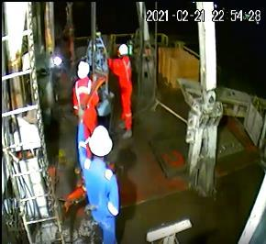

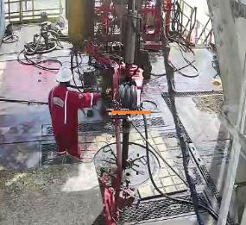

Date: 21.02.2021 Incident title : HiPo#14
What happened?
On 21st February, 2021 @ 22:54 hours, while pulling out and laying down 3 1/2" tubing, the power tong suddenly swung while breaking the connection (11th Joint) and pushed the floor-man backward, falling to ground.
No injury reported.
Your learning from this incident.
Always adhere to standard operating procedures.
While breaking out torqued connection, start with low gear on the power tong
Regular checks of die condition to ensure they are clean
Always use correct length snub/Safety line
Dedicated tagged snub lines to be kept with store man
Always Ensure correct length snub line is used on all tongs

Slide 2
Management self audit
Management self audit
Date: 21.02.2021 Incident title: HIPO#14
As a learning from this Near Miss and ensure continual improvement all contract
managers must review their HSE HEMP against the questions asked below
Confirm the following:
Do you ensure your SOP capture all hazards regarding snub line and power tongs?
Do you ensure the supervisor physically verify the correct length of snub line prior to start the operation?
Do you ensure the implementation of learning from incidents?
Do you ensure continuous compliance with actions from learning?
Do you ensure that snub line are tagged for correct equipment?
Do you ensure that tong jaws are regularly cleaned (after every 2 to 3 joints) while pulling old tubing?
* If the answer is NO to any of the above questions please ensure you take action to correct this finding.
Notes:
Ensure all dates and titles are input
Make a list of closed questions (only ‘yes’ or ‘no’ as an answer) to ask others if they have the same issues based on the management or HSE-MS failings or shortfalls identified in the investigation.
Imagine you have to audit other companies to see if they could have the same issues.
These questions should start with: Do you ensure…………………?

