Slide 1
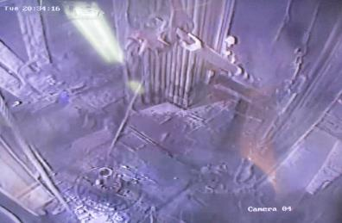
PDO Second Alert
Date: 08.08.2022 Incident title: HiPo#14 Pattern: DROPS Potential severity: B4P
Target Audience: Drilling
What happened?
On 08.02.2022 at 2034hrs drilling of 12 ¼”section was in progress. The MWD tool was prepared on the ground and picked up to the rig floor using the crane.
At the rig floor, the elevator was latched on the lifting sub and the top sling was removed. A rope had been attached to the elevator as an aid to disengage the elevator from the lifting sub and make up TDS to continue drilling.
The crane and the Driller started picking up the tool. While picking up the tool, the rope got caught by the safety clamp.
The tension built on the rope opened the elevator and as the result one end of the tool fell on to the rig floor from the height of 3m while the other end was rigged to the crane. No injuries. No equipment damage.
Why it happened/Finding :
The length of the tool was 10.46m. The weight of the tool was approx. 600kg.
The entangled rope pulled the elevator. The elevator opened and the tool fell onto the rig floor
No intervention was made to stop the job and free the entangled rope as it was not seen
The SOP was not adequate and did not cover all the steps of the task
The Zone management was maintained. No one was standing in the line of fire
The dynamic risk assessment was not performed
Supervision of the task was inadequate
Your learning from this incident..
Don’t use rope to open the elevators from the rig floor
Always maintain zone management and be aware of the line of fire hazards
Always perform pre-task risk assessment and implement controls
Always hold pre-task safety meeting and review SOP
Always intervene and exercise STOP Work Authority
Always ensure adequate supervision
Capture from CCTV footage: the rope got caught on the safety clamp
STOP! Never use the rope and/or unlatch elevator until you make it up to Top Drive
Notes:
Ensure all dates and titles are input
A short description should be provided without mentioning names of contractors or individuals. You should include, what happened, to who (by job title) and what injuries this resulted in. Nothing more!
Four to five bullet points highlighting the main findings from the investigation. Remember the target audience is the front line staff so this should be written in simple terms in a way that everyone can understand.
The strap line should be the main point you want to get across
The images should be self explanatory, what went wrong (if you create a reconstruction please ensure you do not put people at risk) and below how it should be done.

Slide 2
Management self audit
Date: 08.08.2022 Incident title: HiPo#14 Pattern: DROPS Potential severity: B4P
As a learning from this incident and ensure continual improvement all contract managers must review their HSE risk management against the questions asked below
Confirm the following:
Do you ensure that your supervisors are competent to identify the uncounted risks and implement control measures?
Do you ensure that there is communication between the field and Senior management on changes required to be made for work instructions?
Do you ensure that Senior management is involved in the proactive CCTV footage review process?
Do you ensure that CCTV review process focuses on the compliance with SOP and triggers actions to address nonconformities?
* If the answer is NO to any of the above questions please ensure you take action to correct this finding
Notes:
Ensure all dates and titles are input
Make a list of closed questions (only ‘yes’ or ‘no’ as an answer) to ask others if they have the same issues based on the management or HSE-MS failings or shortfalls identified in the investigation.
Imagine you have to audit other companies to see if they could have the same issues.
These questions should start with: Do you ensure…………………?

