Slide 1
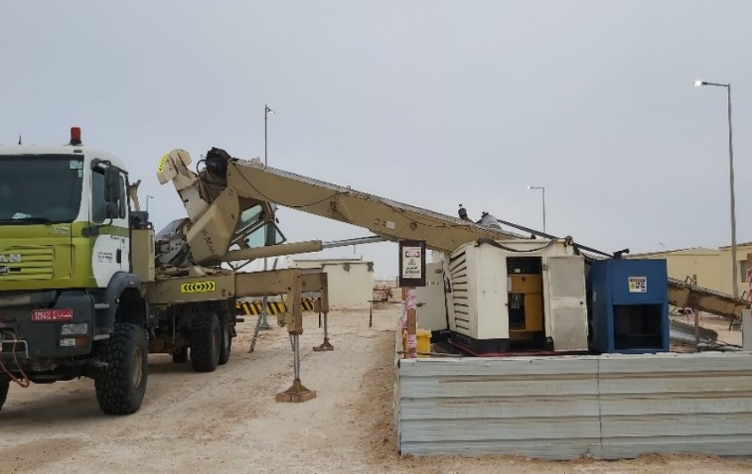
PDO Second Alert
Date: 23/02/2021 Incident title : HiPo#14a
What happened?
A hired crane was being used to lift a generator from a temporary barricaded area onto a low-bed. After the load was slung, the operator began lifting the load which was beyond the load bearing capacity, the weight proved to be too heavy for the crane to sustain , causing the crane cabin to get dislodged from its position.
The boom along with the generator dropped to the ground causing damage to the crane and the generator.
No personnel involved in the activity were injured.
Your learning from this incident.
Ensure the implementation of lift plan, TRIC and risk assessment for all lifting activities.
Conduct TBT and discuss the 10 questions for safe lift to all personnel involved in the task.
Ensure Lifting supervisor is supervising the lifting operation.
STOP Lifting operation on finding any unsafe condition or act.
Non -Compliance with Lifting Plan
Always ensure compliance with SP 2273
Notes:
Ensure all dates and titles are input
A short description should be provided without mentioning names of contractors or individuals. You should include, what happened, to who (by job title) and what injuries this resulted in. Nothing more!
Four to five bullet points highlighting the main findings from the investigation. Remember the target audience is the front line staff so this should be written in simple terms in a way that everyone can understand.
The strap line should be the main point you want to get across
The images should be self explanatory, what went wrong (if you create a reconstruction please ensure you do not put people at risk) and below how it should be done.

Slide 2
Management self audit
Date: 23/02/2021 Incident title : HiPo#14a
As a learning from this incident and ensure continual improvement all contract
managers must review their HSE HEMP against the questions asked below
Confirm the following:
Do you ensure all involved personnel attend the TBT ?
Do you ensure 10 questions for safe lift is discussed with all personnel involved in the task.
Do you ensure trial lifts are conducted prior to commencement of lift?
Do you ensure lifting supervisor is available at all times during lifting operations (exceeding 4 ton)?
Do you ensure lifting plans and risk assessments are created for all lifting operations ?
Do you ensure strict following of the lifting plan (working radius, boom length, load weight) ?
Do you carry checks as per SP 2273 at regularly to ensure compliance ?
Do you carry out competency assessments periodically for entire lifting crew?
* If the answer is NO to any of the above questions please ensure you take action to correct this finding
Notes:
Ensure all dates and titles are input
Make a list of closed questions (only ‘yes’ or ‘no’ as an answer) to ask others if they have the same issues based on the management or HSE-MS failings or shortfalls identified in the investigation.
Imagine you have to audit other companies to see if they could have the same issues.
These questions should start with: Do you ensure…………………?

