Slide 1
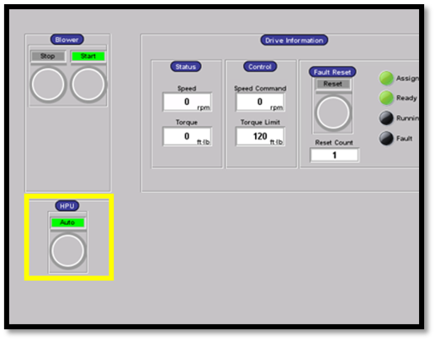
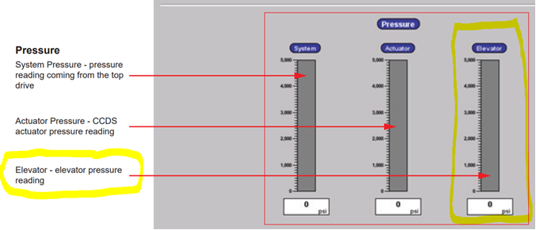
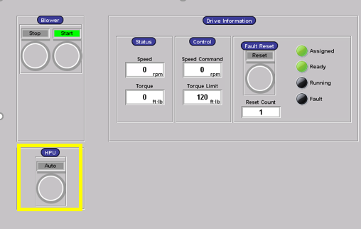
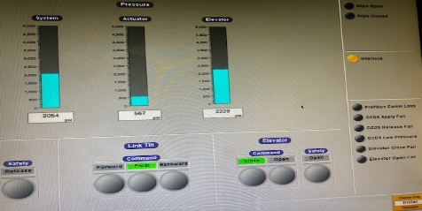
PDO Second Alert
Date:14/03/2023 Incident title: HIPO#15 Pattern: LOF/DROP Potential severity: D4P
Target Audience: Rigs & Hoists – Drillers, Assistant Drillers and equipment operators
What happened?
On 14.03.2023 at around 16:16 hours, while laying down the 9.5/8" landing joint, the driller closed the Hydraulic Single Joint Elevator (HSJE). Then he picked up the landing joint, and the floor man pushed the joint's pin end into the catwalk's trough. The driller then started to lower the joint into the trough. While doing so, the HSJE unexpectedly opened, causing the joint to fall, bounce onto the rig floor and land on the ground with its coupling side resting on the V-Door. The zone management was in place and no injury to anyone.
Why it happened/Finding :
The elevator and safety latch function tests were conducted successfully in accordance with the Elevator Product Manual. No abnormalities.
The TDS HPU was operating in Auto mode, which includes a 5-minute timeout period. After 5 minutes of inactivity, the HPU system will automatically stop, and the system pressure drop to zero.
The driller failed to notice that the HPU was off (display on screen + alarm activated on the display).
The HSJE is equipped with a mechanical lock as a secondary barrier, but can not keep the elevator in a closed position in the event of a system pressure loss and a joint in an inclined position (weight loss).
The Catwalk area has metal chain as a barrier (as per SP-2097 DROPS standard), the off-driller side chain was temporarily removed to allow the forklift to access the catwalk to remove the landing joint.
The CCTV records shows that the crew complied with the red zone and the no-go zone requirement.
Why was it repeated?
The driller failed to acknowledge the alarm on the driller display and failed to notice the hydraulic system pressure drop on the CRT screen
Your learning from this incident :
Driller and AD to ensure compliance with the zone management system.
Driller and AD to ensure that the TDS HPU is set to the "ON Mode" when using the CRT.
Maintenance team to consult the OEM of the TDS & HSJE elevator to upgrade the hydraulic system to prevent the elevator from opening in case of system pressure loss.
Driller and AD to concentrate on ongoing operation, check all reading (HPU hydraulic pressure, alarms, etc.).
TDS HPU in Auto mode during Run CSG with CRT
TDS HPU in ON mode during Run CSG with CRT
Be vigilant during operation, regularly check HPU hydraulic pressure and monitor alarms
Notes:
Ensure all dates and titles are input
A short description should be provided without mentioning names of contractors or individuals. You should include, what happened, to who (by job title) and what injuries this resulted in. Nothing more!
Four to five bullet points highlighting the main findings from the investigation. Remember the target audience is the front line staff so this should be written in simple terms in a way that everyone can understand.
The strap line should be the main point you want to get across
The images should be self explanatory, what went wrong (if you create a reconstruction please ensure you do not put people at risk) and below how it should be done.

Slide 2
Management self audit
Date:14/03/2023 Incident title: HIPO#15 Pattern: LOF/DROP Potential severity: D4P
As a learning from this incident and ensure continual improvement all contract managers must review their HSE risk management against the questions asked below
Confirm the following:
Do you ensure, procedures are clear and understood by site team?
Do you ensure, site team is following the procedures?
Do you ensure, site team is fully aware about safety features/interlock?
Do you ensure, driller is aware that “ON” mode must be used while operating CRT?
Do you ensure, driller is aware about the consequences on CRT incase of hydraulic system pressure drop?
* If the answer is NO to any of the above questions, please ensure you take action to correct this finding
Notes:
Ensure all dates and titles are input
Make a list of closed questions (only ‘yes’ or ‘no’ as an answer) to ask others if they have the same issues based on the management or HSE-MS failings or shortfalls identified in the investigation.
Imagine you have to audit other companies to see if they could have the same issues.
These questions should start with: Do you ensure…………………?

