Slide 1
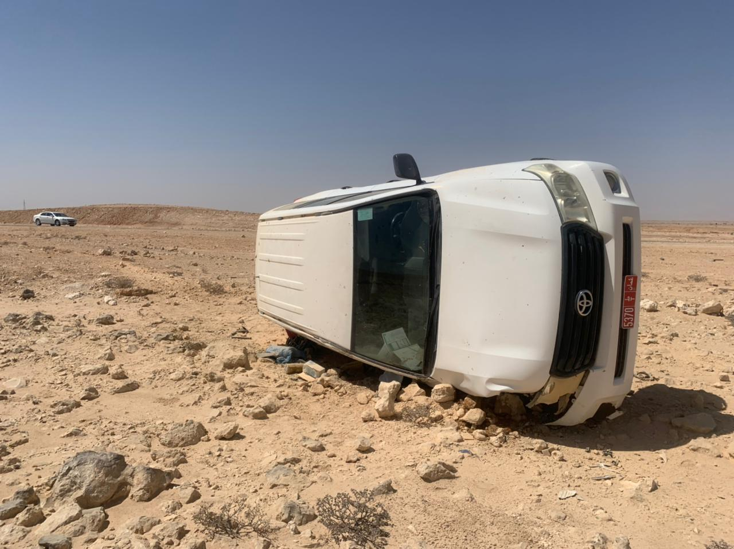
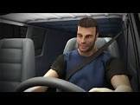
PDO Second Alert
Date:24/02/2022 Incident title: HiPo#15 Pattern: MVI Potential severity: D4P
Show real pic
Target Audience: Drilling, Logistics, Operation & Construction
What happened?
On 24th Feb 2022, a 54 years old PDO Mechanical Technician was traveling on Toyota land cruiser from Rima, Nimr and to Marmul to attend Medical Examination. While traveling back to Rima he lost control of his vehicle and tilied at passenger side. As a result of incident, the vehicle got damaged and driver escaped form any injury.
Emergency response was initiated, and ambulance arrived at incident location then sent Amal Clinic for further Examination.
Why it happened/Finding :
Direct immediate and underlying causes. Add essential information only with a direct link to incident.
Driving for long Journey with no rest (Driver fatigue)
Safe Journey Management did not indicate rest timings.
Driver fail to apply Defensive Driving (DD) skills when driver loos control of the vehicle
Your learning from this incident..
Always when you feel tired of fatigue stop and take rest
Always ensure to Follow SJM routs and rest timings
Always ensure to apply DD techniques when driving
Observe Fatigue Sign while Driving and stop driving if required
Notes:
Ensure all dates and titles are input
A short description should be provided without mentioning names of contractors or individuals. You should include, what happened, to who (by job title) and what injuries this resulted in. Nothing more!
Four to five bullet points highlighting the main findings from the investigation. Remember the target audience is the front line staff so this should be written in simple terms in a way that everyone can understand.
The strap line should be the main point you want to get across
The images should be self explanatory, what went wrong (if you create a reconstruction please ensure you do not put people at risk) and below how it should be done.

