Slide 1
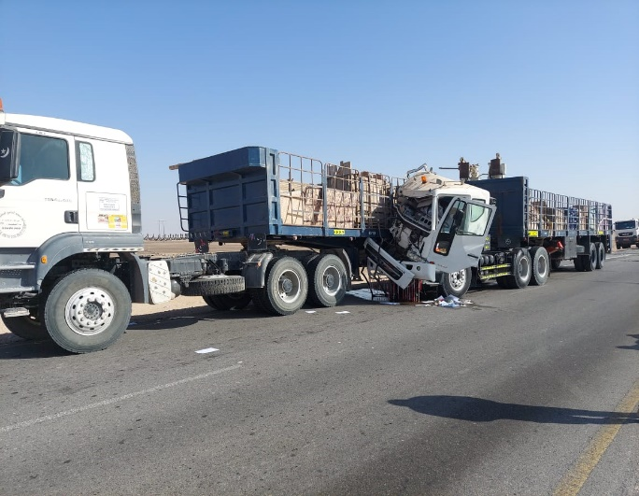

PDO Second Alert
Date: 4.3.2021 Incident title : HiPo#15- MVI
What happened?
Two trailers proceeding on the black top, one in the front and other moving behind were transporting materials for the project.
The driver of the trailer in front observed a pothole and slowed down and switched on the hazard light. The driver of the trailer coming from behind was unable to control and collided with front trailer. No injuries.
Your learning from this incident..
Never use cell phone while driving
Always ensure to report damaged / bad road conditions
Always ensure 4 seconds rules as safe clearance distance
Always ensure to drive according to road conditions
Always ensure to apply defensive driving techniques
Driver lost control while driving
While driving, always stay focus & never use your cell phone
Driver shall always comply with Life saving rules and not use mobile phone while driving

Slide 2
Management Self Audit
Date: 4.3.2021 Incident title : HiPo#15- MVI
As a learning from this incident and ensure continual improvement all contract
managers must review their HSE HEMP against the questions asked below
Confirm the following:
Do you ensure to routinely remind defensive driving techniques in Driver’s Forums, TBT, etc?
Do you ensure drivers do not use mobile phones while driving?
Do you ensure regular campaigns on LSR ?
Do you carry out regular counseling on behavior interventions for drivers?
Do you have a mechanism to analyses driver behavior based on IVMS data and give feedback?
* If the answer is NO to any of the above questions please ensure you take action to correct this finding.
2
Notes:
Ensure all dates and titles are input
Make a list of closed questions (only ‘yes’ or ‘no’ as an answer) to ask others if they have the same issues based on the management or HSE-MS failings or shortfalls identified in the investigation.
Imagine you have to audit other companies to see if they could have the same issues.
These questions should start with: Do you ensure…………………?

