Slide 1
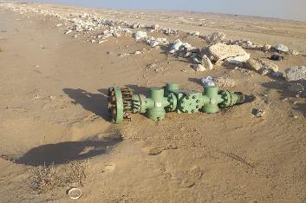
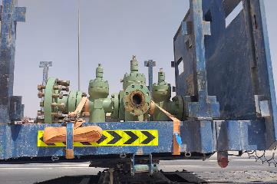
PDO Second Alert
Date: 05.03.2021 Incident title: HIPO #18
What happened?
On 5th March 2021 ,driver from a 3rd party contracted logistics supplier had just collected Xmas tree from the well head maintenance yard at Fahud .The vehicle was travelling on the Fahud to Lekhwair road and turned off towards Yibal, entering an ‘S’ bend junction. The junction has a left turn followed immediately by a right turn.
As the prime mover with trailer was moving through the second bend, a ratchet type sling securing the Xmas tree on the trailer broke allowing the Xmas tree to fall off the side of the trailer, landing directly into the sand on the left side of the road.
Your learning from this incident..
Always ensure to validate securing equipment is in good working condition
Always ensure your driving speed is appropriate for the road conditions, even when within speed limits
Always ensure drivers check the loads at appropriate times and in safe places along the route.
Always ensure the load is correctly secured as per SP2001
Notes:
Ensure all dates and titles are input
A short description should be provided without mentioning names of contractors or individuals. You should include, what happened, to who (by job title) and what injuries this resulted in. Nothing more!
Four to five bullet points highlighting the main findings from the investigation. Remember the target audience is the front line staff so this should be written in simple terms in a way that everyone can understand.
The strap line should be the main point you want to get across
The images should be self explanatory, what went wrong (if you create a reconstruction please ensure you do not put people at risk) and below how it should be done.

Slide 2
Management self audit
Date: 05.03.2021 Incident title: HIPO #18
As a learning from this incident and ensure continual improvement all contract
managers must review their HSE HEMP against the questions asked below
Confirm the following:
Do you ensure that your drivers are trained to assume the responsibility of their loads?
Do you ensure that drivers are monitored for suitable and correct driving practices?
Do you have a system in place for capturing and sharing the learnings from previous incidents?
Do you ensure regular compliance audits for road safety and load security and also covering your subcontractor?
Do you ensure that the incident and fault reporting system is robust, and includes sub-contractors?
Do you ensure that you follow up on corrective action from previous auditing?
Do you ensure that drivers are competent to secure loads properly especially when the load changes at off-site locations
* If the answer is NO to any of the above questions please ensure you take action to correct this finding.
Notes:
Ensure all dates and titles are input
Make a list of closed questions (only ‘yes’ or ‘no’ as an answer) to ask others if they have the same issues based on the management or HSE-MS failings or shortfalls identified in the investigation.
Imagine you have to audit other companies to see if they could have the same issues.
These questions should start with: Do you ensure…………………?

