Slide 1
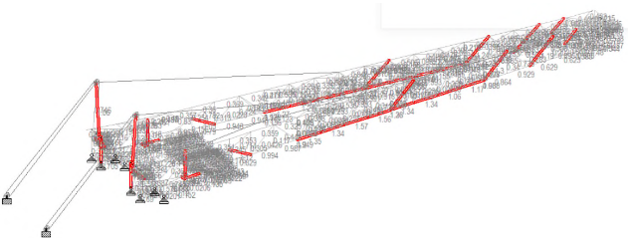
PDO Second Alert
Date:10/04/2023 Incident title: Mast Damage Pattern: Asset Damage or Hi-Po Event Potential severity: C4A…. Activity: ….
Target Audience: Drilling, Rig Managers, Drillers, Drilling Superintendents
What happened?
While raising the mast, at about 1.5m height above the high stand, the hook load weight was suddenly lost and simultaneously the mast crown block section descended on top of the high stand causing severe structural damages.
All personnel were outside the NO-GO Zone thus no injury to personnel (Fail Safe).
As an immediate action, after incident Crew was instructed to leave & barricaded area.
Why it happened/Finding :
Maximum allowable raising hook load was neither specified by OEM or Rig’s SOP.
MOC process was not followed at the upgrade done in 2009.
Structural stress analysis was not done during Mast upgrade.
Procedure in place did not cover raising friction trends monitoring.
Your learning from this incident..
Always ensure that No-Go Zone is properly implemented
Always Know your working envelop & design limitation
Ensure SOP is updated whenever a change takes place.
Ensure MOC process is in place and properly implemented
Mast Structural Deformed Sections
Mast Structural Integrity Verification
Always Know Your Working Envelop & Design Limitation
Notes:
Ensure all dates and titles are input
A short description should be provided without mentioning names of contractors or individuals. You should include, what happened, to who (by job title) and what injuries this resulted in. Nothing more!
Four to five bullet points highlighting the main findings from the investigation. Remember the target audience is the front line staff so this should be written in simple terms in a way that everyone can understand.
The strap line should be the main point you want to get across
The images should be self explanatory, what went wrong (if you create a reconstruction please ensure you do not put people at risk) and below how it should be done.

Slide 2
Management self audit
Date:10/04/2023 Incident title: Mast Damage Pattern: Asset Damage or Hi-Po Event Potential severity: C4A…. Activity: ….
As a learning from this incident and ensure continual improvement all contract managers must review their HSE risk management against the questions asked below
Confirm the following:
Do you know what is the maximum allowable limits while raising and lower the mast?
Do you issue a MOC for any major modification?
Do you ensure any upgrade is reviewed by Qualified technical expert ( SME)?
Do you ensure your procedures are reviewed whenever required?
* If the answer is NO to any of the above questions please ensure you take action to correct this finding
Notes:
Ensure all dates and titles are input
Make a list of closed questions (only ‘yes’ or ‘no’ as an answer) to ask others if they have the same issues based on the management or HSE-MS failings or shortfalls identified in the investigation.
Imagine you have to audit other companies to see if they could have the same issues.
These questions should start with: Do you ensure…………………?

