Slide 1
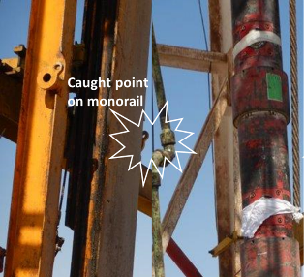
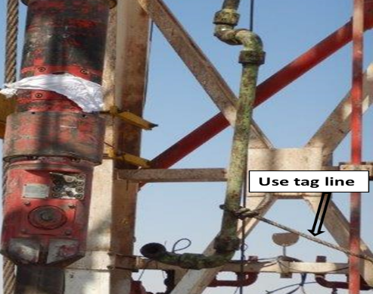
PDO Second Alert
Date: 02/03/2022 Incident title: HiPo#19/Equipment Pattern: DROPS Potential severity: C4P
Target Audience: Drilling, Hoist Operations
What happened?
The Liner cement head was picked up with the TDS in order to stab-in into pup joint which was placed at rotary table level, the chicksan joint got caught in the TDS monorail causing the Lo-torque valve connection to part and TPW (Temporary Pipe Work) assembly to fall on rig floor. No personnel injuries.
The weight of TPW assembly (Lo-torque + swivel + chicksan) is 133 kg and it fell from 4m height.
Why it happened/Finding :
Escalation by the change of plan (adding the extra pup-joint) led to distracted focus to perform critical check on TDS travel path.
Crew present on rig floor were focusing on stabbing the cement head assembly into the pup-joint and were not attentive to the potential risk caused by TPW.
Supervisors involved in the process didn’t stop the activity to perform detailed risk assessment with new TBT when deviation took place.
Your learning from this incident..
Rig Manager & Driller to always assess the risk when deviating for original plan.
Driller to always ensure the TDS travel path is clear from obstruction & temporary objects installed at height properly secured.
Floormen to always position themselves to avoid moving objects and dropped objects.
DSV, Rig Manager & Driller to always ensure effective supervision for any task.
Make sure that travel path is clear from obstructions
Notes:
Ensure all dates and titles are input
A short description should be provided without mentioning names of contractors or individuals. You should include, what happened, to who (by job title) and what injuries this resulted in. Nothing more!
Four to five bullet points highlighting the main findings from the investigation. Remember the target audience is the front line staff so this should be written in simple terms in a way that everyone can understand.
The strap line should be the main point you want to get across
The images should be self explanatory, what went wrong (if you create a reconstruction please ensure you do not put people at risk) and below how it should be done.

Slide 2
Management self audit
Date: 02/03/2022 Incident title: HiPo#19 /Equipment Pattern: DROPS Potential severity: C4P
As a learning from this incident and ensure continual improvement all contract managers must review their HSE risk management against the questions asked below
Confirm the following:
Do you ensure that all risks are assessed, controls in place & communicated to all parties involved when deviation occurs from original plan?
Do you ensure that a work procedure is developed for all tasks?
Do you ensure that employees at site are complying with the procedures?
Do you ensure that temporary objects installed at height are adequately secured and guided using tag line?
* If the answer is NO to any of the above questions please ensure you take action to correct this finding
Notes:
Ensure all dates and titles are input
Make a list of closed questions (only ‘yes’ or ‘no’ as an answer) to ask others if they have the same issues based on the management or HSE-MS failings or shortfalls identified in the investigation.
Imagine you have to audit other companies to see if they could have the same issues.
These questions should start with: Do you ensure…………………?

