Slide 1
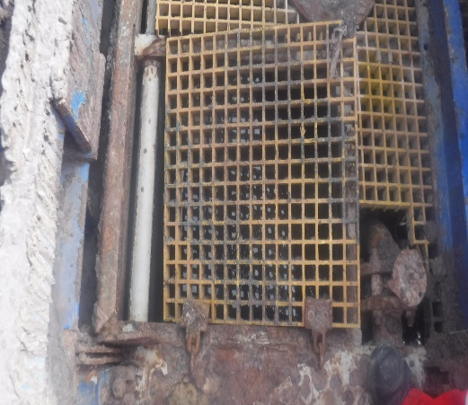
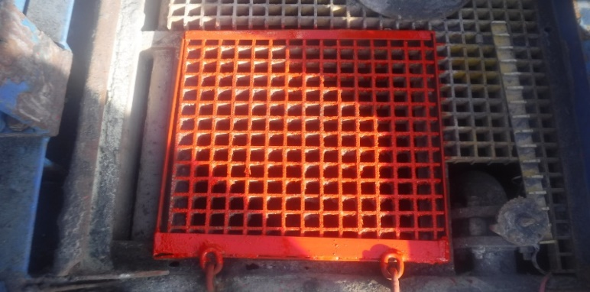
PDO Second Alert
Date: 17.03.2021 Incident title: HiPo#19
What happened?
On 17th March 2021 @ 11:05 hours, electrician was walking in shale shaker area (Near shale shaker # 3), when he stepped on settling tank gate grating edge, the grating got imbalanced and electrician foot went into the tank.
No injury reported.
Your learning from this incident..
Always ensure grating gates are clean and secured properly.
Ensure tanks grating are inspected to identify potential hazards
Ensure that working area is clear of slip, trip and fall hazards
Frequently check the gate hinges condition and report any damages / corrosion
Ensure tanks gratings are part of weekly hazard hunts
Grating Gate was unsecured
Grating Gate is secured by four sided frame
Always ensure design of frame fully supports gate openings on all sides
Notes:
Ensure all dates and titles are input
A short description should be provided without mentioning names of contractors or individuals. You should include, what happened, to who (by job title) and what injuries this resulted in. Nothing more!
Four to five bullet points highlighting the main findings from the investigation. Remember the target audience is the front line staff so this should be written in simple terms in a way that everyone can understand.
The strap line should be the main point you want to get across
The images should be self explanatory, what went wrong (if you create a reconstruction please ensure you do not put people at risk) and below how it should be done.

Slide 2
Management self audit
Date: 17.03.2021 Incident title: HiPo#19
As a learning from this incident ensure all the gates on mud tanks supported with proper frames and secured well
Confirm the following:
Do you ensure grating gates are clean and secured properly.
Do you ensure all the gates on tanks supported with proper frames
Do you ensure all frame work is free of corrosion
Do you ensure to frequently check the gate hinges condition for corrosion.
* If the answer is NO to any of the above questions please ensure you take action to correct this finding
Notes:
Ensure all dates and titles are input
Make a list of closed questions (only ‘yes’ or ‘no’ as an answer) to ask others if they have the same issues based on the management or HSE-MS failings or shortfalls identified in the investigation.
Imagine you have to audit other companies to see if they could have the same issues.
These questions should start with: Do you ensure…………………?

