Slide 1
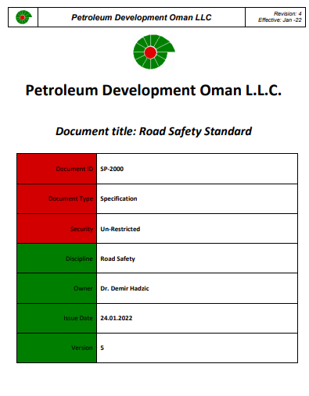
PDO Second Alert
Date:25/04/2023 Incident title: HiPo#20 Pattern: MVI Potential severity: C4P Activity: Pre-move road transport
Target Audience: Drivers, Journey Managers, Supervisors (All Units)
What happened?
On the 25th of April @12:19 hrs., during slick line operation prior to well release, Rig Manager sent loads in advance from Barik to Saih Rawl (43 km). Prime mover with pipes bin trailer commenced road transport in advance, and when the trailer crossed 28 km from the original location, the driver lost control of the vehicle resulting in a tip-over to the right side. He was wearing a seatbelt and was secured in his seat. The driver stepped out of the vehicle and was transferred to Saih Rawl PAC clinic by a passerby’s car. The driver had a minor frontal scalp injury and was sent for a CT scan to rule out internal injuries. Results were normal and driver returned to work location after psychological safety was assured via provision of counselling.
Why it happened/Finding :
The driver was wearing a seatbelt. He attended TBT prior to starting the job. Mustaed was discussed.
The driver was hired via a subcontractor. He had valid defensive driving license and FTW.
The prime mover had valid ROP registration. The trailer had a standard width.
The vehicle is connected to IVMS. Journey Plan was issued.
The speed was within limit (average 62 km/h).
The driver heard an abnormal sound moments before the vehicle diverged away from the main road. The driver’s reaction was to bring the vehicle back, he may have over corrected, resulting in unbalance and a tip-over.
The trailer was designed for pipes in a secured bin, but it had other equipment loaded on it.
The loose loads were not inspected and properly secured before departure from original location.
Your learning from this incident..
Drivers to always be vigilant in identifying all road hazards especially while driving loads on graded road and practice defensive driving techniques.
Driver to always use the Load Securing checklist, and ensure loads are secured correctly and verified by a supervisor (Rig/Site Manager) prior to departure.
Rig Manager to always ensure to send advanced loads in a convoy with escort, whenever possible.
Drivers and Journey Managers to always ensure to follow Road Safety Standards prior to starting any journey.
Always Comply with Road Safety Standards & Proper Load Securing
Notes:
Ensure all dates and titles are input
A short description should be provided without mentioning names of contractors or individuals. You should include, what happened, to who (by job title) and what injuries this resulted in. Nothing more!
Four to five bullet points highlighting the main findings from the investigation. Remember the target audience is the front line staff so this should be written in simple terms in a way that everyone can understand.
The strap line should be the main point you want to get across
The images should be self explanatory, what went wrong (if you create a reconstruction please ensure you do not put people at risk) and below how it should be done.

Slide 2
Management self audit
Date:25/04/2023 Incident title: HiPo#20 Pattern: MVI Potential severity: C4P Activity: Pre-move road transport
Confirm the following:
Do you ensure procedure is being well implemented and followed without anyone taking shortcuts?
Do you ensure all carried loads are properly secured and verified by a competent person?
Do you ensure potential risks are identified and discussed with the drivers prior to starting the journey?
Do you ensure the preventive maintenance of the vehicles is carried out as per the schedule?
Do you ensure that sub-contractors’ employees are well aware of the company’s procedures and standards?
* If the answer is NO to any of the above questions please ensure you take action to correct this finding
Notes:
Ensure all dates and titles are input
Make a list of closed questions (only ‘yes’ or ‘no’ as an answer) to ask others if they have the same issues based on the management or HSE-MS failings or shortfalls identified in the investigation.
Imagine you have to audit other companies to see if they could have the same issues.
These questions should start with: Do you ensure…………………?

