Slide 1
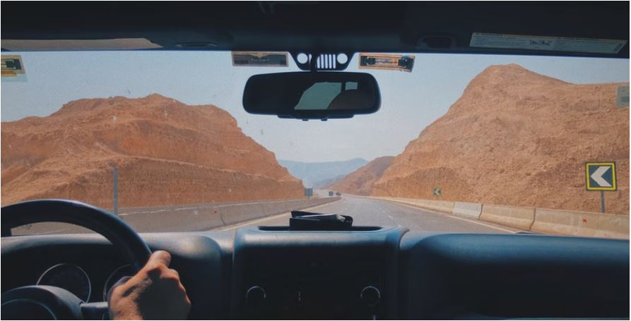
PDO Second Alert
Date:05/03/2022 Incident title: HiPO#21 Pattern: MVI Potential severity: C4P
Target Audience: Drilling, Logistics, Operation & Construction
Photo explaining what was done wrong
What happened?
On 5 March 2022 at 04:20 am, the floorman who was feeling sick and was transported from Hoist Camp to Haima hospital (23 KM). About 1 KM to the hospital at 05:05 am, on the black top road, a trailer came on the same lane of the pickup from the opposite direction. The driver tried to avoid it and took a sharp turn to the left resulting in the vehicle hitting the streetlight tower.
No one got injured.
Why it happened/Finding :
Driving during foggy weather and poor visibility.
Journey was initiated without obtaining night driving approval
Weather was not foggy when the journey started
Your learning from this incident..
Always stop driving if the weather is foggy and visibility is limited
Always obtain PDO approval for driving at night (excluding trips to and fro camp-hoist).
Always stop and communicate with the Journey Manager if the weather condition changes and affects the visibility (Fog, Dust etc)
Always seek support from nearest clinic/Rig camp to avoid driving at Night
Do not drive the vehicle if the horn is not working
Photo explaining how it should be done right
Never Drive in foggy weather and limited visibility
Notes:
Ensure all dates and titles are input
A short description should be provided without mentioning names of contractors or individuals. You should include, what happened, to who (by job title) and what injuries this resulted in. Nothing more!
Four to five bullet points highlighting the main findings from the investigation. Remember the target audience is the front line staff so this should be written in simple terms in a way that everyone can understand.
The strap line should be the main point you want to get across
The images should be self explanatory, what went wrong (if you create a reconstruction please ensure you do not put people at risk) and below how it should be done.

Slide 2
Management self audit
Date:05/03/2022 Incident title: HiPO#21 Pattern: MVI Potential severity: C4P
As a learning from this incident and ensure continual improvement all contract managers must review their HSE risk management against the questions asked below
Confirm the following:
- Do you ensure that all night driving journeys are approved? (Excluding Hoist – camp - Hoist)?
- Do you ensure that the drivers stop the vehicle during foggy weather conditions?
- Do you ensure that the IVMS keys are not misused by the drivers?
- Do you ensure your Driver stop driving if defects on critical equipment?
- Do you ensure that the competency assessment elements are covering emergency during night?
* If the answer is NO to any of the above questions please ensure you take action to correct this finding
Notes:
Ensure all dates and titles are input
Make a list of closed questions (only ‘yes’ or ‘no’ as an answer) to ask others if they have the same issues based on the management or HSE-MS failings or shortfalls identified in the investigation.
Imagine you have to audit other companies to see if they could have the same issues.
These questions should start with: Do you ensure…………………?

