Slide 1
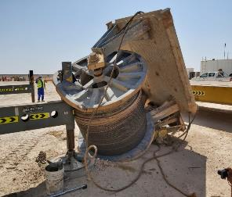
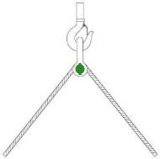
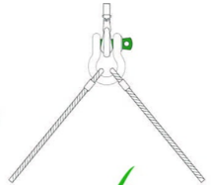
PDO Second Alert
Date:10/03/2022 Incident title: HiPo#22 Pattern: DROPS Potential severity: B4P
What happened?
On 10th March 2022, at 13:50 hours, a crane was lifting a drill spool load intending to place it onto a lowbed trailer. The load was suspended approx. 1.5m from the ground. A Rig Move Supervisor was assisting the lowbed in a reversing motion to be placed under the load (normal practice). The “gooseneck” of the manoeuvring vehicle then came into contact with the suspended drilling spool causing it to unbalance the load. As the slings had been incorrectly placed the force of this unbalance caused the load to drop to the ground. The spool rested on one of the outriggers of the crane.
Why it happened/Finding :
The Crew failed to refer the Lift plan for this particular lift
Incorrect rigging method used
Improper Work Planning: The lowbed was not parked appropriately at initial stage (prior lifting)
The RMS was positioned inappropriately when signaling the lowbed
Your learning from this incident..
Always follow the Lift plan whenever applicable and use correct slinging method as advised on it
Always attach the sling through the sling eyes. Never pass the sling through the hook
Always carryout dynamic risk assessment
Always be position in correct manner where you see/control the hazards, seek assistance if requires any
Always use your empowerment to STOP if you feel anything unsafe
Ensure you follow the Lift Plan / Use correct rigging method
Target Audience: All contractors within PDO concession
Notes:
Ensure all dates and titles are input
A short description should be provided without mentioning names of contractors or individuals. You should include, what happened, to who (by job title) and what injuries this resulted in. Nothing more!
Four to five bullet points highlighting the main findings from the investigation. Remember the target audience is the front line staff so this should be written in simple terms in a way that everyone can understand.
The strap line should be the main point you want to get across
The images should be self explanatory, what went wrong (if you create a reconstruction please ensure you do not put people at risk) and below how it should be done.

Slide 2
Management Self Audit
Date:10/03/2022 Incident title: HiPo#22 Pattern: DROPS Potential severity: B4P
As a learning from this incident and ensure continual improvement all contract managers must review their HSE risk management against the questions asked below
Confirm the following:
Do you ensure your staff understand and follow the approved lift plan?
Do you ensure your staff understand and apply the correct rigging on loads
Does your Rig Move crews carry out a pre lift TBT with the lifting operation?
Does your Rig Move crews ensure only sling eyes are attached to the crane hook?
Does your Rig move crews ensure that they lift the load high enough for reversing vehicles to be positioned under? (tandem lift only)
Do you ensure your employees always use their empowerment to stop?
Do you ensure that your supervision are competent to carry out their duties?
* If the answer is NO to any of the above questions please ensure you take action to correct this finding
Notes:
Ensure all dates and titles are input
Make a list of closed questions (only ‘yes’ or ‘no’ as an answer) to ask others if they have the same issues based on the management or HSE-MS failings or shortfalls identified in the investigation.
Imagine you have to audit other companies to see if they could have the same issues.
These questions should start with: Do you ensure…………………?

