Slide 1
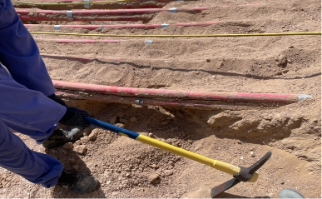
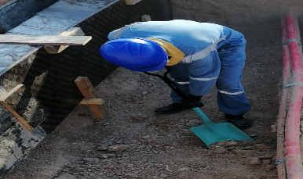
PDO Second Alert
Date:09-03-2022 Incident title: HiPo#23 Pattern: Cable Damage Potential severity: C4P
Target Audience: Drilling, Logistics, Operation & Construction
What happened?
On 9th March 2022, at around 1440 hrs, a civil crew involved in soil removal around the exposed LV and HV cables to install form work protection outside of KGP station (100 Meters to the main gate) hit and punctured a HV cable while attempting to loosen the hard strata beneath, using a pickaxe. This resulted in tripping of KGP station.
The crew stopped the activity and reported to the Station Operator immediately. At around 1600 hrs, the KGP station resumed operations after rectification by Electrical Team.
Why it happened/Finding :
Cable trench designed to be constructed beneath the live LV and HV cables; isolating the cables supplying power to KGP was not feasible .
PTW controls, method statement, JHSEP, TRIC are inadequate in terms of specifying the right methodology, tools, safeguard required for this scenario (removing hard strata from beneath the live cables) without isolation.
Permit Applicant ignored the risk involved in breaking the hard strata beneath the live cables and assigned the activity to Permit Holder without adequate briefing.
Crew tasked with soil removal beside and underneath the exposed cables, encountered hard strata as there was no soft soil spread beneath the cables.
Permit Holder did not consider stopping the work and seeking, instead chose to break the hard strata using pickaxe when the soil could not be removed using non-metallic shovel.
Your learning from this incident
Always use non-metallic tools close to live electric cables
Pickaxes shall not be used within 1m distance of any live electric cable
Always be prepared to stop work and ask for advice when faced with challenges
Encourage co-workers to “STOP” any unsafe act
Beware of live electrical cables; follow precautions
Notes:
Ensure all dates and titles are input
A short description should be provided without mentioning names of contractors or individuals. You should include, what happened, to who (by job title) and what injuries this resulted in. Nothing more!
Four to five bullet points highlighting the main findings from the investigation. Remember the target audience is the front line staff so this should be written in simple terms in a way that everyone can understand.
The strap line should be the main point you want to get across
The images should be self explanatory, what went wrong (if you create a reconstruction please ensure you do not put people at risk) and below how it should be done.

Slide 2
Management self audit
Date:09-03-2022 Incident title: HiPo#23 Pattern: Cable Damage Potential severity: C4P
As a learning from this incident and ensure continual improvement all contract managers must review their HSE risk management against the questions asked below
Confirm the following:
Do you ensure that you have competent Supervisors at site?
Do you ensure that the crew members are familiar with their activity and the hazards involved?
Do you ensure that you are providing proper and sufficient tools for the site teams?
Do you ensure that your employees are using the correct tools for the job?
Do you ensure that your employees are aware of their empowerment to stop work when faced with challenges or if the job is not safe?
Do you ensure that your employees are in possession of specific method statement and are following the PTW guidelines?
* If the answer is NO to any of the above questions please ensure you take action to correct this finding
Notes:
Ensure all dates and titles are input
Make a list of closed questions (only ‘yes’ or ‘no’ as an answer) to ask others if they have the same issues based on the management or HSE-MS failings or shortfalls identified in the investigation.
Imagine you have to audit other companies to see if they could have the same issues.
These questions should start with: Do you ensure…………………?

