Slide 1
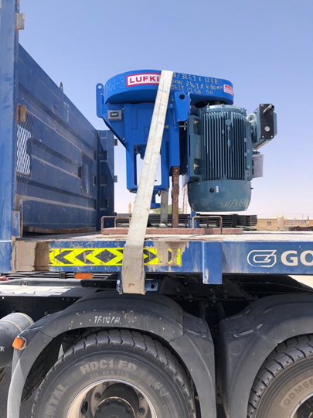
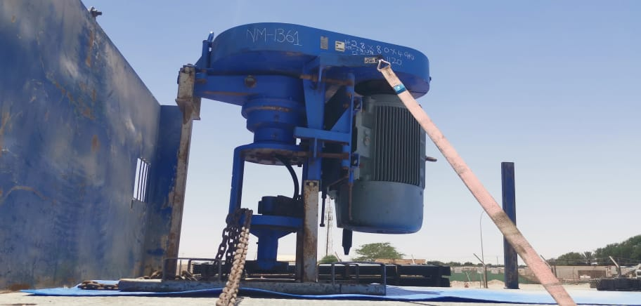
PDO Second Alert
Date: 2nd April 2021 Incident title: HIPO#23 (Drop)
What happened?
On 2nd April 2021 a hired flat bed truck was loaded with 2 numbers of PCP Drive head to be delivered to Tuqa well site. At 2 KM before the well site and while turning right at excessive speed (28 km/hr), one of the drive heads slipped off from the trailer ended outside the graded road, due to failure of load securement. PCP Drive head sustained damages on belts guard and motor terminal Box. no injuries sustained to personnel.
Your learning from this incident..
Always ensure comply with SP2001 of load securement before starting the trip.
Always make pre-use inspection for all load securement equipment.
Always adjust friction mat under the load to avoid movement of load during the trip.
Always stop at intervals to check load securement during the trip.
Always ask for assistance from competent load inspector if you are not sure about the load securement.
Photo explaining what was done wrong
Always follow load and restraining procedure while securing the load
Notes:
Ensure all dates and titles are input
A short description should be provided without mentioning names of contractors or individuals. You should include, what happened, to who (by job title) and what injuries this resulted in. Nothing more!
Four to five bullet points highlighting the main findings from the investigation. Remember the target audience is the front line staff so this should be written in simple terms in a way that everyone can understand.
The strap line should be the main point you want to get across
The images should be self explanatory, what went wrong (if you create a reconstruction please ensure you do not put people at risk) and below how it should be done.

Slide 2
Management self audit
Date: Incident title
As a learning from this incident and ensure continual improvement all contract
managers must review their HSE HEMP against the questions asked below
Confirm the following:
Do you ensure compliance with SP2001 of load securement before starting the trip
Do you ensure SP2001 loading/off loading and securement hazards well communicated to your team.
Do you ensure carry out and specify L3 Audit for all critical hazards.
Do you ensure regular inspections conducted for loading securement compliance.
Do you ensure system in place to ensure your supervisor are supervising critical hazards.
Do you ensure availability of competent load inspector to Conduct load restraint inspections on all types of load
* If the answer is NO to any of the above questions please ensure you take action to correct this finding.
Notes:
Ensure all dates and titles are input
Make a list of closed questions (only ‘yes’ or ‘no’ as an answer) to ask others if they have the same issues based on the management or HSE-MS failings or shortfalls identified in the investigation.
Imagine you have to audit other companies to see if they could have the same issues.
These questions should start with: Do you ensure…………………?

