Slide 1
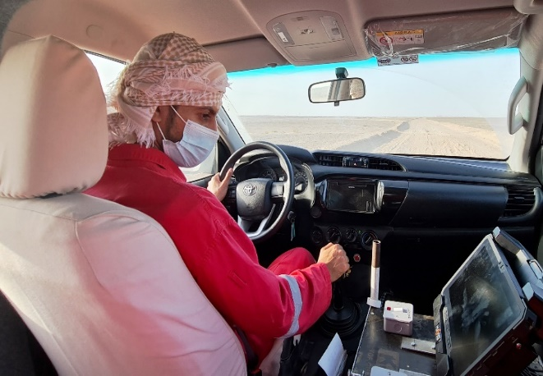
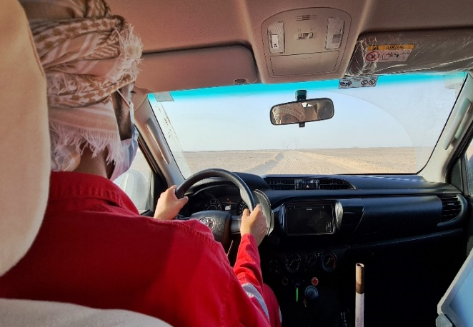
PDO Second Alert
Date: 11.04.2021 Incident title: HiPo#24-MVI
What happened?
On April 11, 2021, at 10:26 one trouble shooter vehicle had rolled over in the Jebel area. This vehicle was assigned to a trouble shooter, who drives vehicle to perform the Node daily QC. The vehicle had rolled over from about 6 meters height and possibly rolled 2 to 3 times and landed on his wheels. Fortunately driver escaped from vehicle and only minor skin abrasion on the right hand two fingers.
Your learning from this incident..
Always Focus on driving and do not get distracted
Always check the surrounding terrain condition while driving in off road especially in rough area.
STOP and check if unsure on the forward route
Always report Unsafe Condition to your supervisor and correct if it is safe to do.
Always Focus on driving and do not get distracted
Notes:
Ensure all dates and titles are input
A short description should be provided without mentioning names of contractors or individuals. You should include, what happened, to who (by job title) and what injuries this resulted in. Nothing more!
Four to five bullet points highlighting the main findings from the investigation. Remember the target audience is the front line staff so this should be written in simple terms in a way that everyone can understand.
The strap line should be the main point you want to get across
The images should be self explanatory, what went wrong (if you create a reconstruction please ensure you do not put people at risk) and below how it should be done.

Slide 2
Management self audit
Date: 11.04.2021 Incident title: HiPo#24-MVI
As a learning from this incident and ensure continual improvement all contract
managers must review their HSE HEMP against the questions asked below
Confirm the following:
Do you ensure that risk assessment is carried out before commencement of activity?
Do you ensure that a work procedure is developed for all tasks?
Do you ensure that the risk assessments and procedures are up to date?
Do you ensure that there are sufficient controls in place to bring the risk to ALARP?
Do you ensure that drivers always follow driving procedures?
Do you ensure right equipment are in place before commencement of task.?
* If the answer is NO to any of the above questions please ensure you take action to correct this finding.
Notes:
Ensure all dates and titles are input
Make a list of closed questions (only ‘yes’ or ‘no’ as an answer) to ask others if they have the same issues based on the management or HSE-MS failings or shortfalls identified in the investigation.
Imagine you have to audit other companies to see if they could have the same issues.
These questions should start with: Do you ensure…………………?

