Slide 1
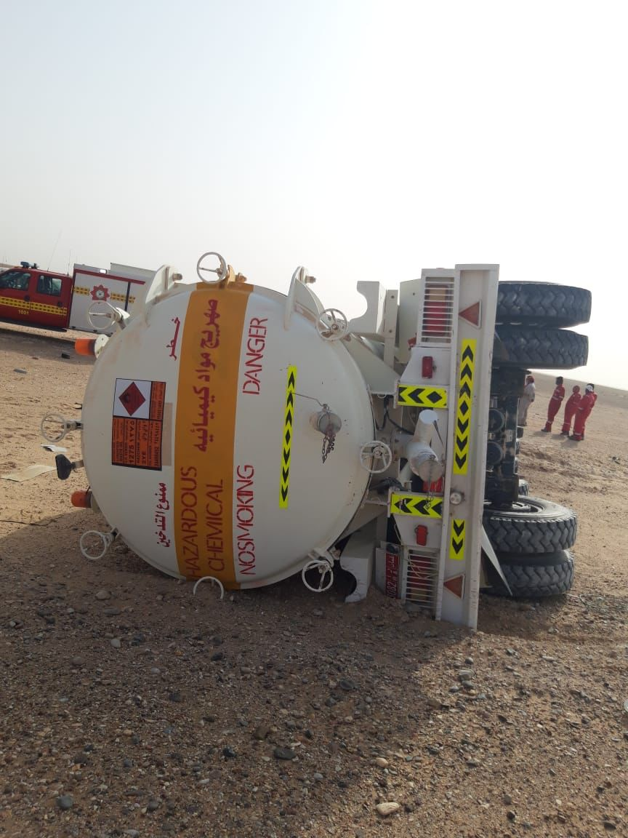
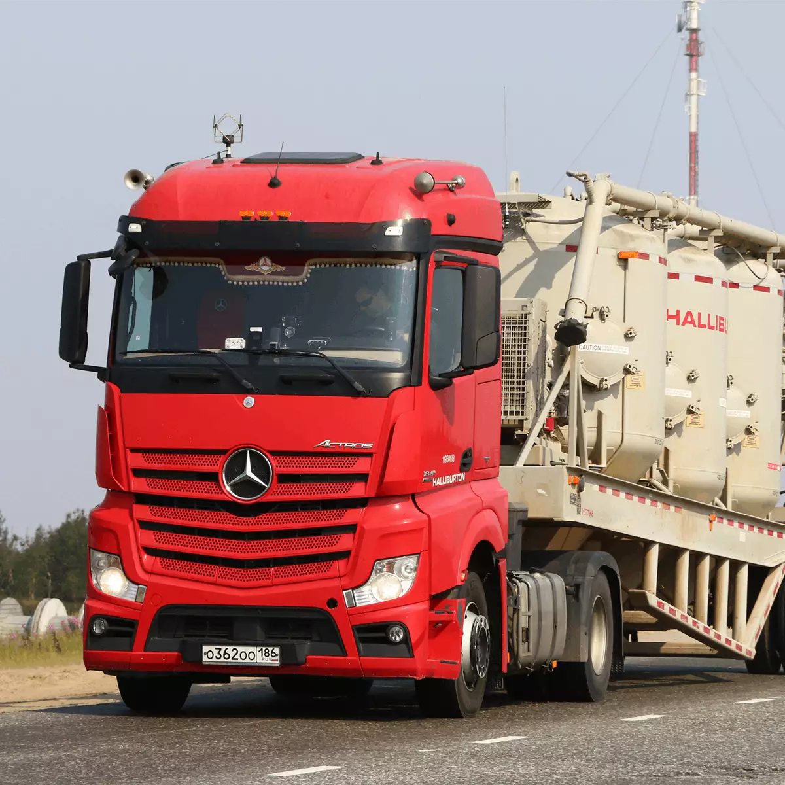
PDO Second Alert
Date:18-03-2022 Incident title: MVI RO Pattern: MVI Potential severity : C4P
Target Audience : Upper Shuaiba Rigs ( Product lines dispatchers ,Drivers ,Foreman and Maintence Supervisors
What happened?
On 18th Mar 2022 @ 14:31 hours, the driver left from Lekhwair from rig heading to Fahud, before reaching Fahud by around 50 Km the 8th gears shifted to neutral the driver trying to get back to its positions but not able to interlock, he used both hands to do it again the vehicle start to turn away from the track and the driver could not return it back then the truck turn over on the left of the road..
Why it happened/Finding :
Diver failed to stop driving the defective truck
Gear box failure has been reported during the first quarter over 10 times hence maintenance report was lacking the detailed work order of the gear box
Halliburton subcontractor driver with more than 7 years of experiences (3 years with Oxy as water tanker – 2 years PDO was water tanker – 2 years non-oil field areas). No violations recorded within rag reports.
Failure to properly maintain the truck in good conditions
Third party company failed to ensure defective truck is being put in the road
Your learning from this incident..
Ensure all drivers apply STOP Work Authority in case defective equipment are encountered
Maintenance workshop to ensure that all trucks in the road are fully maintained as per OEM
Ensure all drivers to comply with safe driving practice/technique
Never drive any defective truck/vehicle and never hesitate to stop driving it
Notes:
Ensure all dates and titles are input
A short description should be provided without mentioning names of contractors or individuals. You should include, what happened, to who (by job title) and what injuries this resulted in. Nothing more!
Four to five bullet points highlighting the main findings from the investigation. Remember the target audience is the front line staff so this should be written in simple terms in a way that everyone can understand.
The strap line should be the main point you want to get across
The images should be self explanatory, what went wrong (if you create a reconstruction please ensure you do not put people at risk) and below how it should be done.

Slide 2
Management self audit
Date:18-03-2022 Incident title: truck turn over Pattern: MVI Potential severity : C4P
As a learning from this incident and ensure continual improvement all contract managers must review their HSE risk management against the questions asked below
Confirm the following:
-Do you ensure safe driving techniques are applied
-Do you Ensure STOP Work Authority is applied
-Do you ensure proper maintenance is performed
-Do you ensure your sub contractors are audited
-DO you ensure learnings are shared and actions are applied
* If the answer is NO to any of the above questions please ensure you take action to correct this finding
Notes:
Ensure all dates and titles are input
Make a list of closed questions (only ‘yes’ or ‘no’ as an answer) to ask others if they have the same issues based on the management or HSE-MS failings or shortfalls identified in the investigation.
Imagine you have to audit other companies to see if they could have the same issues.
These questions should start with: Do you ensure…………………?

