Slide 1
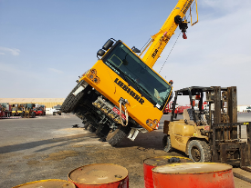

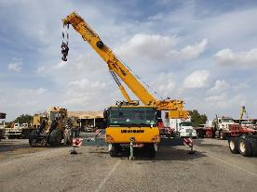
PDO Second Alert
Date: 15.04.2021 Incident title HiPo#25.
What happened?
A crane operator was in the workshop having some minor panel repairs to his crane, when the mechanic requested that the operator remove the counterweights so he could get access to the broken panel. The operator slewed his boom, picked up the counterweights and when he was slewing his boom back around the crane toppled over due to the operator not extending his outriggers for support.
Your learning from this incident..
Crane Operators
Always ensure you have your outriggers fully extended when slewing the boom.
Always ensure to follow the load chart prior operating the crane.
Always ensure a signaller is in place prior operating the crane.
Always ensure you do not rush to finish a task, take your time and do it safely.
Always ensure you use your empowerment to STOP if you feel that it is unsafe, even if the workshop gives you instructions to do something.
Always ensure to consider any warning signals within the cab
Workshop Foreman / Mechanics
Always ensure you check that all cranes before operated have their outriggers extended as per the load chart.
Always ensure you check that all personnel (your staff and others in the area) are out of the line of fire before starting any movement of cranes.
Always ensure you conduct a 4CAAP (4 Point Crosscheck, Assure & Accountability Programme) before starting tasks
Retracted Outriggers
Extended Outriggers
ALWAYS FULLY EXTEND YOUR OUTRIGGERS!
Notes:
Ensure all dates and titles are input
A short description should be provided without mentioning names of contractors or individuals. You should include, what happened, to who (by job title) and what injuries this resulted in. Nothing more!
Four to five bullet points highlighting the main findings from the investigation. Remember the target audience is the front line staff so this should be written in simple terms in a way that everyone can understand.
The strap line should be the main point you want to get across
The images should be self explanatory, what went wrong (if you create a reconstruction please ensure you do not put people at risk) and below how it should be done.

Slide 2
Management self audit
Date: 15.04.21 Incident title HiPo#25
As a learning from this incident and ensure continual improvement all contract
managers must review their HSE HEMP against the questions asked below
Confirm the following:
Do you ensure there are adequate Safe Systems of Work in place for repairing cranes and they are understood and followed by all?
Do you ensure workshop supervisors ensure cranes and other vehicles follow all safety precautions at the workshop?
Do you ensure all crane operations are assigned a lifting supervisor and banksman?
Do you ensure employees follow their agreed shift pattern?
Do you ensure that employees are aware of line of fire hazards?
Do you ensure employees are instructed to stop and react correctly on hearing a warning alarm?
Do you ensure you provide adequate levels of maintenance supervision?
Do you ensure you barricade the area around maintenance works to prevent unauthorised?
* If the answer is NO to any of the above questions please ensure you take action to correct this finding.
Notes:
Ensure all dates and titles are input
Make a list of closed questions (only ‘yes’ or ‘no’ as an answer) to ask others if they have the same issues based on the management or HSE-MS failings or shortfalls identified in the investigation.
Imagine you have to audit other companies to see if they could have the same issues.
These questions should start with: Do you ensure…………………?

