Slide 1
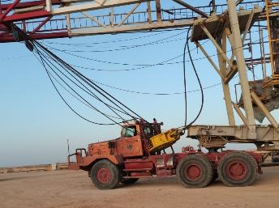
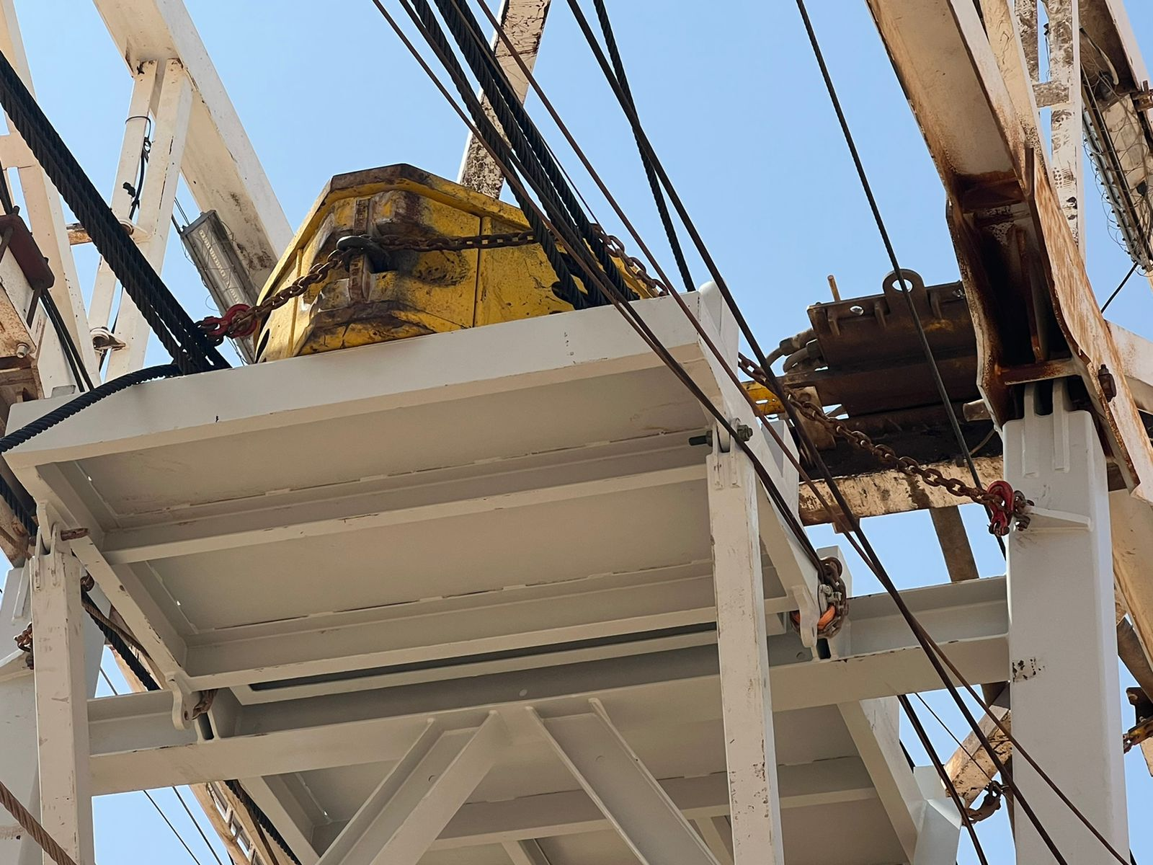
PDO Second Alert
Date: 23.03.2022 Incident title: HiPo#26 Pattern: DROPS Potential severity: C3P
Target Audience: Rig Manager, Driller, AD, Rig Move contractor personnel
What happened?
On 23.03.2022 at 1200pm Rig-82 was released, and rig down was in progress. The mast was lowered, the travelling block was laid on the mast support beam platform, and the rig carrier was connected to the prime mover.
At approx. 1825hrs the prime mover pulled the rig carrier out from the well center and started moving down the slope to exit the location. At the end of the slope the Driver applied the brake, the travelling block followed the momentum, shifted from its place and slid towards the Driver’s cabin through the raising lines. At the time of the incident the speed was 4km/h.
In the result of the impact, the platform behind the Driver’s cabin, the Fire extinguisher and the bars got damaged. No injuries. The Driver exited the truck thru the passenger door.
Why it happened/Finding :
Zone management was maintained, and no one was standing in the line of fire
There were no personnel or vehicles near the vicinity of the rig carrier
The mast support beam platform is OEM designed for positioning the travelling block
The Driver was alone in the cabin at the time of the event
There was no free fall. The travelling block slid forward held by the raising lines
The travelling block had not been secured prior to the move
Supervision of the task was inadequate. Haste was implied by the Supervisor
Your learning from this incident..
Always take time to inspect the equipment prior to the move for any loose items
Always follow safe work practices and exercise Stop-Work-Authority if required
Never take shortcuts and/or imply haste
Always plan the rig move in advance and implement controls for potential risks
Always maintain zone management and stay away from Line of Fire
Always Restrain Loads Prior To Moving
Notes:
Ensure all dates and titles are input
A short description should be provided without mentioning names of contractors or individuals. You should include, what happened, to who (by job title) and what injuries this resulted in. Nothing more!
Four to five bullet points highlighting the main findings from the investigation. Remember the target audience is the front line staff so this should be written in simple terms in a way that everyone can understand.
The strap line should be the main point you want to get across
The images should be self explanatory, what went wrong (if you create a reconstruction please ensure you do not put people at risk) and below how it should be done.

Slide 2
Management self audit
Date: 23.03.2022 Incident title: HiPo#26 Pattern: DROPS Potential severity: C3P
As a learning from this incident and ensure continual improvement all contract managers must review their HSE risk management against the questions asked below
Confirm the following:
Do you ensure that the assurance framework within your organization is implemented?
Do you ensure that findings from the assurance checks are recorded and properly followed up?
Do you ensure that the critical contractors are audited to ensure compliance with the requirements?
Do you ensure that the frontline supervisors are sufficiently competent in order not to take shortcuts at the expense of safety?
Do you ensure that procedures for the critical tasks are available?
Do you ensure that there is a clear understanding that unrestrained loads cannot and shall not be moved?
* If the answer is NO to any of the above questions please ensure you take action to correct this finding
Notes:
Ensure all dates and titles are input
Make a list of closed questions (only ‘yes’ or ‘no’ as an answer) to ask others if they have the same issues based on the management or HSE-MS failings or shortfalls identified in the investigation.
Imagine you have to audit other companies to see if they could have the same issues.
These questions should start with: Do you ensure…………………?

