Slide 1
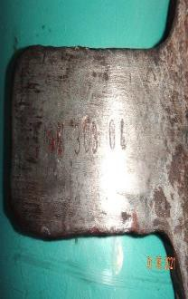
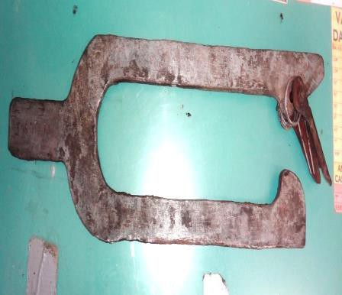
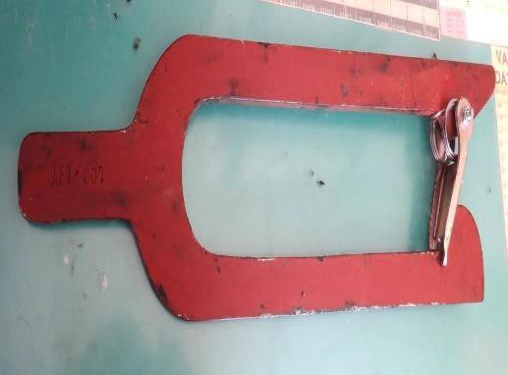
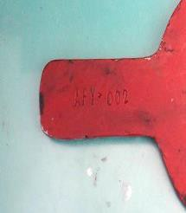
PDO Second Alert
Date: 01.05.2021 Incident title: HiPo#26
What happened?
A Hoist Driller was assisting TMX crew to rotate the reel in pulling out the
remaining rod from the guide to secure it into the reel hub.
While pulling the rod into the transport reel, the continues rod came free about one meter out of the reel, due to one of the 2 safety forks failing (latch failure)
and slightly stuck the hoist driller, resulting in minor cuts to his upper and lower inner lips.
Your learning from this incident..
Always ensure all crew are away from line of fire hazards during tasks
Always ensure to inspect equipment before use
Always ensure to follow SOP, stop and ask if you are in doubt
Always ensure to discuss all hazards, risk and controls during TBT
effectively
Always intervene to stop unsafe acts
Always ensure that red zones are Identified, adequately barricaded, monitored for effectiveness & continually controlled
Never place yourself and others in the line of
fire

Slide 2
Management self audit
Date: 01.05.2021 Incident title: HiPo#26
As a learning from this incident and ensure continual improvement all contract managers must review their HSE HEMP against the questions asked below
Confirm the following:
Do you ensure that your critical safety equipment is discussed during your TBT meetings to ensure that they are safe for their intended purpose?
Do you ensure that your critical safety equipment is included in the pre-job checklist and is implemented
effectively for your operations?
Do you ensure effectiveness of the hazard hunts by constantly reviewing the finding trends and implementing an action plan for rectification?
Do you ensure that all safety critical equipment is covered in your HEMP?
Do you ensure that all safety critical equipment is part of your JSA’s/SOP?
Do you ensure that all tools and equipment go through an acceptance process as per the OEM & client recommendations & standards before putting them in service?
If the answer is NO to any of the above questions, please ensure you take action to correct this finding.

