Slide 1
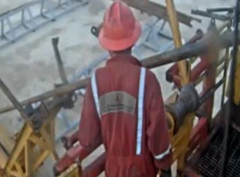
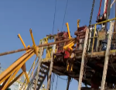
PDO Second Alert
PDO Second Alert
Date: 08.05.2021 Incident title: HiPo#26A Drop
What happened?
While pulling out completion using two safety valves and lay down to pipe rack using pipe cat, due to high stick up and extra length of pre-installed safety valve, using the skate roller. On 21st joint, the floor man open the elevator and the tubing joint along with pre-installed safety valve jumped over the pipe cat basket and the complete joint slide down from floor level to ground. No damage, No injury. No Go zone controlled.
Your learning from this incident..
While laying down tubulars using pipe cat, ensure the pipe is well rested on the roller before proceed to open the elevator.
while laying down pipe using two safety valves, ensure to secure the pipe with winch line before opening elevator.
Always ensure Red Zone –Temporary No go zone are managed all the times.
Always ensure job hazards & potential risk are identified prior to start any task.
Always ensure good communication between floor hands and pipe cat operator.
Ensure the pipe is well rested on the pipe cat roller before proceed to open the elevator.
✓
Notes:
Ensure all dates and titles are input
A short description should be provided without mentioning names of contractors or individuals. You should include, what happened, to who (by job title) and what injuries this resulted in. Nothing more!
Four to five bullet points highlighting the main findings from the investigation. Remember the target audience is the front line staff so this should be written in simple terms in a way that everyone can understand.
The strap line should be the main point you want to get across
The images should be self explanatory, what went wrong (if you create a reconstruction please ensure you do not put people at risk) and below how it should be done.

Slide 2
Management self audit
Management self audit
Date: 08.05.2021 Incident title: HiPo#26A Drop
As a learning from this Near Miss and ensure continual improvement all contract
managers must review their HSE HEMP & JSA against the questions asked below
Confirm the following:
Do you ensure your PSP is covering all type of lay down operations with deferent scenarios?
Do you ensure all risk associated identified & communicated with team?
Do you ensure that OEM provided equipment has any potential of improvement?
Do you ensure that crew members assign dedicated signaler in critical jobs?
* If the answer is NO to any of the above questions please ensure you take action to correct this finding.
Notes:
Ensure all dates and titles are input
Make a list of closed questions (only ‘yes’ or ‘no’ as an answer) to ask others if they have the same issues based on the management or HSE-MS failings or shortfalls identified in the investigation.
Imagine you have to audit other companies to see if they could have the same issues.
These questions should start with: Do you ensure…………………?

