Slide 1
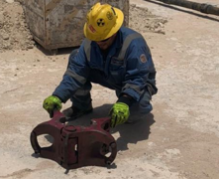
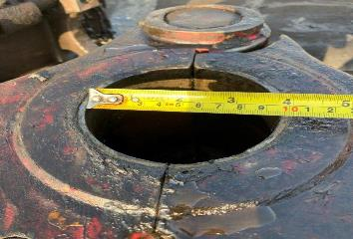
PDO Second Alert
Date: 11.05.2021 Incident title: HIPO #27
What happened?
The crew completed POOH and LD the 3 ½” IF drill pipe. They then prepared the hoist to RIH with 3 ½” EUE tubing by changing out the tubing elevators and then proceeded to prepare the power tongs.
The AD hoisted the first joint up from the catwalk and into the elevators utilizing the winch. The roustabout on the floor proceeded to remove the winch line and soft sling from the pipe. The AD then started hoisting the pipe with the traveling blocks. The pipe’s end was still on the V door and the pipe was about at a 75 deg angle, the pipe slipped through the tubing elevators. The pipe then travelled down the V door onto the catwalk and then fell onto the ground directly beside the catwalk.
Your learning from this incident..
Always ensure effective TBT is conducted before each activity, even if routine.
Always have the responsible person prepare the handling equipment for next job
Always validate size of equipment by measuring or other means, do not leave it to visual validation only.
Always maintain red zone management for all hoisting operations –Do Not hoist if red zone is not cleared
Always ensure all crew members are in their correct positions for all hoisting activities
Always ensure the Drillers to complete their final check of all hoisting equipment prior starting the activity
Always ensure Assistant Drillers only operate the hoist under direct supervision
Do not depend on visual check only
Be certain, measure!
Always properly check equipment before use
Notes:
Ensure all dates and titles are input
A short description should be provided without mentioning names of contractors or individuals. You should include, what happened, to who (by job title) and what injuries this resulted in. Nothing more!
Four to five bullet points highlighting the main findings from the investigation. Remember the target audience is the front line staff so this should be written in simple terms in a way that everyone can understand.
The strap line should be the main point you want to get across
The images should be self explanatory, what went wrong (if you create a reconstruction please ensure you do not put people at risk) and below how it should be done.

Slide 2
Management self audit
Date: 11.05.2021 Incident title: HIPO #27
As a learning from this incident and ensure continual improvement all contract
managers must review their HSE HEMP against the questions asked below
Confirm the following:
Do you ensure you have a monitoring process for implementation of learning from incidents?
Do you have an assurance process for operations planning and utilization of the SOP?
Do you ensure the pre- inspection of equipment before use?
Do you survey the correct personnel are assigned to and doing the job?
Do you ensure compliance to red zone management?
Do you utilise your CCTV monitoring systems to capture non-compliance?
Do you adequately structure your management site visits to monitor compliance?
* If the answer is NO to any of the above questions please ensure you take action to correct this finding.
Notes:
Ensure all dates and titles are input
Make a list of closed questions (only ‘yes’ or ‘no’ as an answer) to ask others if they have the same issues based on the management or HSE-MS failings or shortfalls identified in the investigation.
Imagine you have to audit other companies to see if they could have the same issues.
These questions should start with: Do you ensure…………………?

