Slide 1
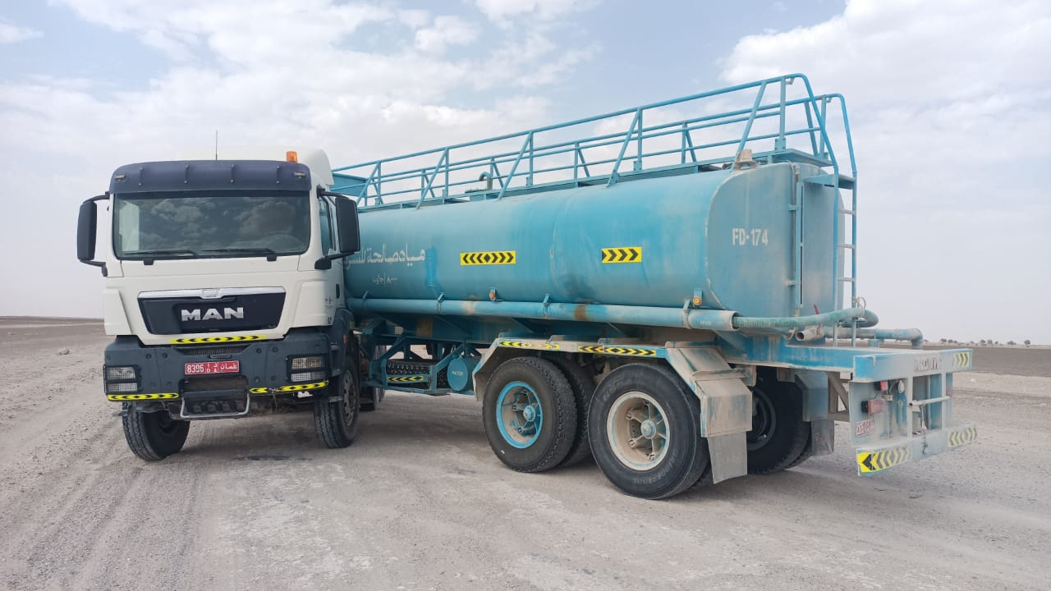
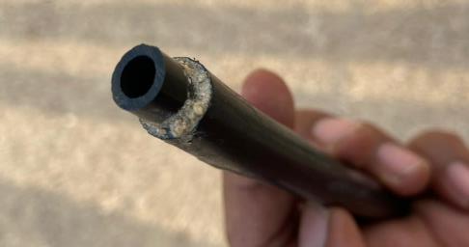
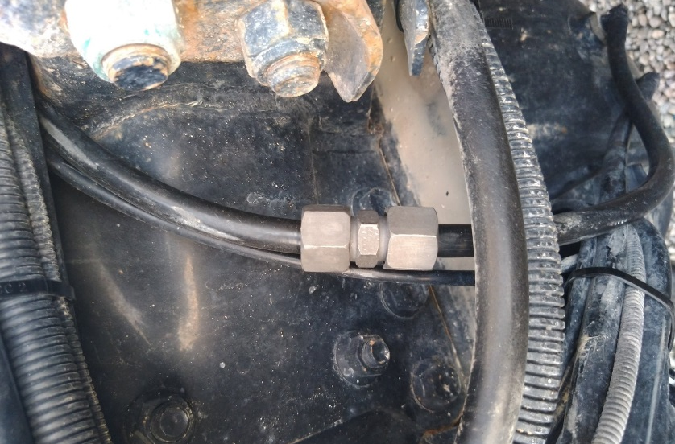
PDO Second Alert
Date: 16.05.21 Incident title: HiPo #27a
What happened?
A water tanker returning to base with an empty tanker was involved in a high potential incident. While travelling, the prime mover suffered a sudden application of the braking system resulting in the emergency brake system locking on, bringing the vehicle to a stop in the jack knife position. It was found that an air hose in the parking brake system was disconnected resulting in the locking up of prime mover wheels. The disconnected air hose was previously repaired using larger diameter hose and superglue following damage.
Your learning from this incident..
Driver
Always ensure you check the vehicle thoroughly before starting the trip and during the trip.
Always ensure you are alert and follow defensive driving techniques while driving.
Always ensure you report all defects.
Workshop Staff
Always ensure you are competent and fully trained to do the job you are assigned
Always ensure you complete a job according to the OEM recommendations / specifications
Always ensure you use genuine spare parts
Always ensure you do not take short cuts or follow substandard repair practices
Always ensure you stop/refuse to do any activity you see unsafe even if it is a common practice.
Always ensure you report anything unsafe to your management.
Improper air hose connection
Ensure you prioritise safety above everything else
Notes:
Ensure all dates and titles are input
A short description should be provided without mentioning names of contractors or individuals. You should include, what happened, to who (by job title) and what injuries this resulted in. Nothing more!
Four to five bullet points highlighting the main findings from the investigation. Remember the target audience is the front line staff so this should be written in simple terms in a way that everyone can understand.
The strap line should be the main point you want to get across
The images should be self explanatory, what went wrong (if you create a reconstruction please ensure you do not put people at risk) and below how it should be done.

Slide 2
Management self audit
Date: 16.05.21 Incident title: HiPo #27a
As a learning from this incident and ensure continual improvement all contract
managers must review their HSE HEMP against the questions asked below
Confirm the following:
Do you ensure spare parts meet OEM standards and specifications?
Do you ensure workshops have access to all parts required?
Do you ensure staff are encouraged to put safety above time / operations?
Do you ensure repairs are conducted in accordance with manufacturer minimum requirements?
Do you ensure all workshop staff competency are conducted?
Do you ensure regular assurance checks are carried out on vehicle maintenance?
* If the answer is NO to any of the above questions please ensure you take action to correct this finding.
Notes:
Ensure all dates and titles are input
Make a list of closed questions (only ‘yes’ or ‘no’ as an answer) to ask others if they have the same issues based on the management or HSE-MS failings or shortfalls identified in the investigation.
Imagine you have to audit other companies to see if they could have the same issues.
These questions should start with: Do you ensure…………………?

