Slide 1
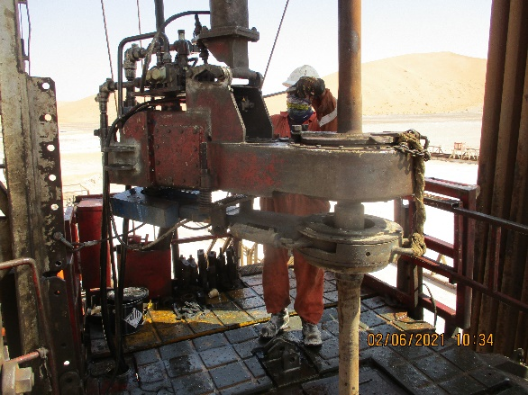
PDO Second Alert
Date: 30.05.2021 Incident type: HiPo #30
What happened?
On 30th May, 2021 at 19:56 hrs; the operation was POOH RBP running tool
with 3.5” DP’s string to derrick. During breaking out connection of DP stand
No. 5 by the power tong, the Floorman picked up the power tong hydraulically,
and rotated the power tong to the left side to grip the connection with make-
up jaws before applying extra torque to break out the joint. While the jaws
dies gripped the joint, the power tong suddenly spun towards the opposite
side and impacted the Floorman on his lower chest which caused him to fall
down on the rig floor.
Your learning from this incident..
Always ensure that the TBT and JSA are discussed in detail and LFI/mitigation measures from risk registers are reviewed with the team.
Always ensure to rotate make-up jaws slowly and carefully until it grips the connection to avoid sudden spins also ensure to engage back-up jaws before break-out connection. Always ensure to engage low gear on the power tong during breakout.
Always ensure the power tong is used with a correct length of snub line.
Always ensure to use the stiff arm when available.
Always ensure that intervention and stop work authority is enforced to stop work from continuing when deemed unsafe.
Always ensure effective supervision is in place.
Ensure the snub line or stiff arm is used correctly.
Notes:
Ensure all dates and titles are input
A short description should be provided without mentioning names of contractors or individuals. You should include, what happened, to who (by job title) and what injuries this resulted in. Nothing more!
Four to five bullet points highlighting the main findings from the investigation. Remember the target audience is the front line staff so this should be written in simple terms in a way that everyone can understand.
The strap line should be the main point you want to get across
The images should be self explanatory, what went wrong (if you create a reconstruction please ensure you do not put people at risk) and below how it should be done.

Slide 2
Management self audit
Date: 30.05.2021 Incident type: HiPo #30
As a learning from this incident and ensure continual improvement all contract
managers must review their HSE HEMP against the questions asked below
Confirm the following:
Do you ensure that the risk register is comprehensive to include all potential risks in hoists operations, particularly pertaining to operating power tongs? (in this incident)
Do you ensure the risk register mitigates the risk that power tong is used with a snub line in sufficient tension?
Do you empower the site leadership to intervene and ensure stop work authority (SWA) is enforced when they witness any mishandling of equipment against approved OEM methodology?
Do you ensure that an SOP is available and used at all times for critical activities at site?
Do you ensure history of PM is available and equipment are checked when received from other units?
Do you ensure adequate supervision and designation of roles and responsibilities are available at the worksite?
Do you ensure LFI from past similar incidents are widely shared across all levels in the organization especially with site leadership teams, and that effectiveness of understanding is assured?
* If the answer is NO to any of the above questions please ensure you take action to correct this finding.
Notes:
Ensure all dates and titles are input
Make a list of closed questions (only ‘yes’ or ‘no’ as an answer) to ask others if they have the same issues based on the management or HSE-MS failings or shortfalls identified in the investigation.
Imagine you have to audit other companies to see if they could have the same issues.
These questions should start with: Do you ensure…………………?

