Slide 1
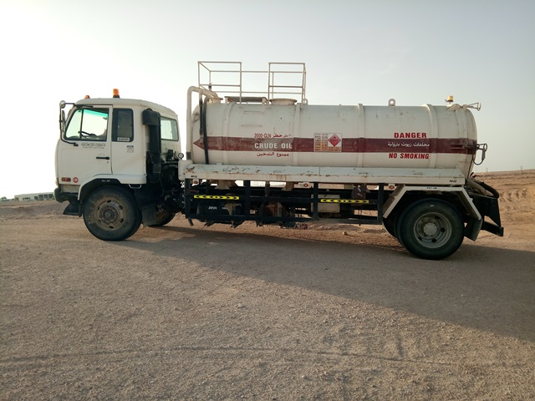
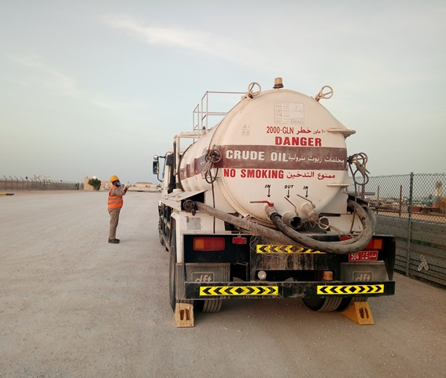
PDO Second Alert
Date: 6th June 2021 HiPo#31
Incident title:- Fire Hydrant Line broken by V. Tanker
What happened?
V. Tanker was assigned to do draining (sucking) of oil inside station. After completing the oil sucking work, Permit Holder decided to remove the V. Tanker from the location to go to PDO Waste Management yard for draining (unloading) of the oil in this process, Permit Holder removed rear wheel chocks. Due to this V. Tanker suddenly started moving downwards on the slope of the ramp where it was parked and hit the fire hydrant line causing damage to the hydrant line and hose reel box.
Your learning from this incident..
Never parked any vehicle on a slope/elevated surface (ramp)
Never remove any wheel chocks without discussing with the driver
Helper shall ensure that the driver is inside vehicle and aware that he is going to remove the wheel chocks
All activity shall be done in a proper sequence.
Toolbox talk shall be conducted before starting any work
Site specific hazards need to be identified & discuss during TBT
Wheel chocks shall be removed only after confirmation from the driver
Notes:
Ensure all dates and titles are input
A short description should be provided without mentioning names of contractors or individuals. You should include, what happened, to who (by job title) and what injuries this resulted in. Nothing more!
Four to five bullet points highlighting the main findings from the investigation. Remember the target audience is the front line staff so this should be written in simple terms in a way that everyone can understand.
The strap line should be the main point you want to get across
The images should be self explanatory, what went wrong (if you create a reconstruction please ensure you do not put people at risk) and below how it should be done.

Slide 2
Management self audit
Date:6th June 2021
Incident title:- Fire Hydrant Line broken by V. Tanker
Confirm the following:
Do you ensure that your supplied employees are having sufficient training to perform their tasks safely?
Do you ensure that TBT is conducted before starting any activity at site?
Do you ensure that Risks and Controls are communicated to personnel at work?
Do you ensure that the communication within the work crew is effective?
Do you ensure that the learning from incidents are effectively cascaded to all workers?
* If the answer is NO to any of the above questions please ensure you take action to correct this finding.
Notes:
Ensure all dates and titles are input
Make a list of closed questions (only ‘yes’ or ‘no’ as an answer) to ask others if they have the same issues based on the management or HSE-MS failings or shortfalls identified in the investigation.
Imagine you have to audit other companies to see if they could have the same issues.
These questions should start with: Do you ensure…………………?

