Slide 1
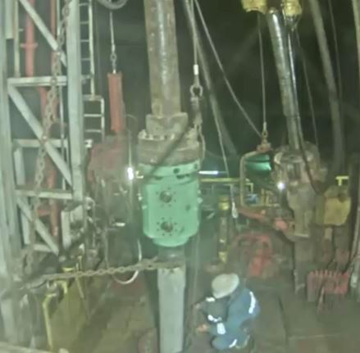
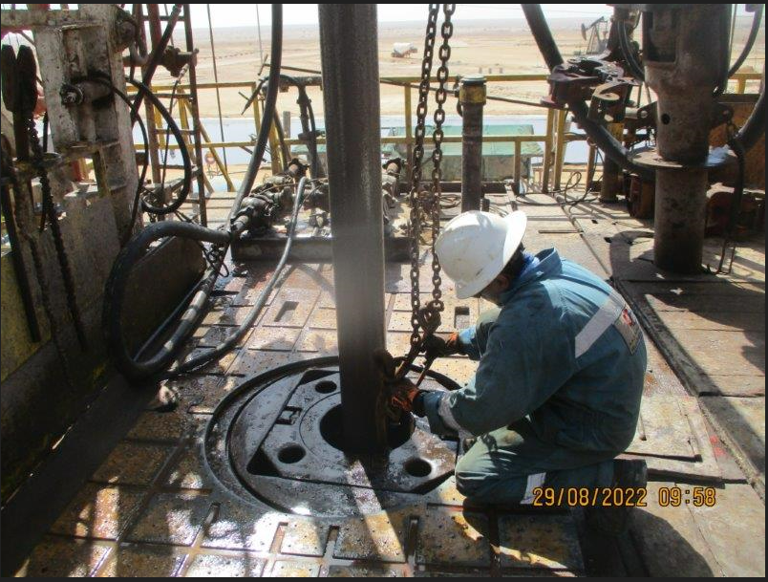
PDO Second Alert
PDO Second Alert
PDO Second Alert
PDO Second Alert
Date: 27th April 2022 Incident title: HIPO#31 Pattern: Released Energy Potential severity: C4P
Target Audience: Units – Rig (Position –NTP and Driller )
What happened?
At approximately 03:00 hrs on 27th of April 2022 running in hole 9-5/8” casing with well head was in progress. In order to pass the well head through the rotary, crew was removing casing insert bowl using bushing puller attached to utility winch. While Driller operated the winch to pick the same, the lifting ring caught into well head tie down bolt (as shown in the red circle). Suddenly, the line got released with stored energy, causing the tension transmitting below and resulting the insert bowl to rapidly release and fall beside the floor man.
Why it happened/Finding :
Bushing chain puller ring was stuck on the well head tie down bolt.
The stuck point was not visible for the driller from his position.
No intervention by the crew members.
TBT had been conducted and discussed about the operation. but SOP doesn’t capture this steps.
The floor man was wearing full body harness with fall arrester.
If it is repeated, Why is it repeated: No
Your learning from this incident..
Ensure to have one floor man watching and communicating while operating air winch for any possible stuck points.
Ensure the Driller verifies the well Head tie down bolts are removed while RIH through Rotary table.
Ensure the Driller verifies well head is minimum 4 – 5 m high while removing the insert bowl to avoid entanglement.
Ensure SOP is available for removal of insert bushings.
Ensure proper supervision by (RM/NTP) for any critical activates.
Always watch for potential entanglement points while operating winch
Notes:
Ensure all dates and titles are input
A short description should be provided without mentioning names of contractors or individuals. You should include, what happened, to who (by job title) and what injuries this resulted in. Nothing more!
Four to five bullet points highlighting the main findings from the investigation. Remember the target audience is the front line staff so this should be written in simple terms in a way that everyone can understand.
The strap line should be the main point you want to get across
The images should be self explanatory, what went wrong (if you create a reconstruction please ensure you do not put people at risk) and below how it should be done.

Slide 2
Management self audit
Date:27/04/2022 Incident title: HiPo#31 Pattern: Released Energy Potential severity: C4P
As a learning from this incident and ensure continual improvement all contract managers must review their HSE risk management against the questions asked below
Confirm the following:
- Do you ensure that the SOP / HEMP covers winch operation during running in casing with well head?
- Do you ensure the availability of key supervisor during critical operations?
- Do you ensure TBT covers full scope of the work?
- Do you ensure potential entanglement points of the winch are identified?
* If the answer is NO to any of the above questions please ensure you take action to correct this finding
Notes:
Ensure all dates and titles are input
Make a list of closed questions (only ‘yes’ or ‘no’ as an answer) to ask others if they have the same issues based on the management or HSE-MS failings or shortfalls identified in the investigation.
Imagine you have to audit other companies to see if they could have the same issues.
These questions should start with: Do you ensure…………………?

