Slide 1
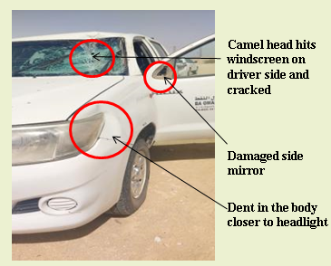
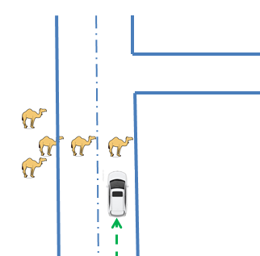


PDO Second Alert
Date: 08.06.2021 Incident Type: HiPo#32- MVI
What happened?
Night Heavy driver after collecting dinner from camp and while his return journey back to hoist by pick up, he hit the crossing camel on Marmul blacktop road at 21:58 Hrs. During this accident, camel's head hits front windscreen on driver side and died at the spot.
Driver sustained with left wrist pain & slight thumb injury.
Your learning from this incident..
Always ensure to keep focus & pay attention on the road especially during night driving
Always ensure to be aware of road crossing camels and stay alert all the time
Always ensure to slow down or stop the vehicle whenever camels were found crossing or on the road side
Always try to avoid unnecessary night driving and maintain lower speeds at night
Always discuss night driving hazards during TBT and ensure all drivers are part of it.
Stay focus & pay attention on the road and crossing camels
Stay Focused, slow down and stop the vehicle when camels are found crossing at road side. Watch out for road warning signs.
Notes:
Ensure all dates and titles are input
A short description should be provided without mentioning names of contractors or individuals. You should include, what happened, to who (by job title) and what injuries this resulted in. Nothing more!
Four to five bullet points highlighting the main findings from the investigation. Remember the target audience is the front line staff so this should be written in simple terms in a way that everyone can understand.
The strap line should be the main point you want to get across
The images should be self explanatory, what went wrong (if you create a reconstruction please ensure you do not put people at risk) and below how it should be done.

Slide 2
Management self audit
Date: 08.06.2021 Incident Type: HiPo#32- MVI
As a learning from this incident and ensure continual improvement all contract
managers must review their HSE HEMP against the questions asked below
Confirm the following:
Do you ensure all hazards and risk mitigation for driving activity are covered during your TBT?
Do you ensure that mammals on road is part of your discussion during learning meetings?
Do you ensure all vehicles has valid RAS and comply with SP2000 requirements?
Do you ensure your Road safety procedure and HEMP covers hazard of Camel crossing?
Do you ensure speed during night driving is strictly adhered with the procedures?
* If the answer is NO to any of the above questions please ensure you take action to correct this finding.
Notes:
Ensure all dates and titles are input
Make a list of closed questions (only ‘yes’ or ‘no’ as an answer) to ask others if they have the same issues based on the management or HSE-MS failings or shortfalls identified in the investigation.
Imagine you have to audit other companies to see if they could have the same issues.
These questions should start with: Do you ensure…………………?

