Slide 1
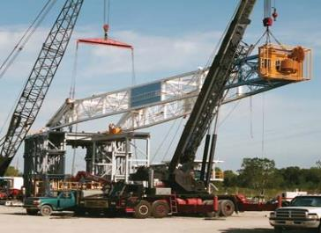
PDO Second Alert
Date:07/05/2022 Incident title: HiPo#32 Pattern: DROPS Potential severity: C4P
Target Audience: Drilling, Logistics, Operation & Construction
What happened?
On 07th May 2022 at 04:36 AM after scope-in the top section successfully and started to lower bottom section, it lowered fast in an uncontrolled manner from 80deg to 40deg and then got stopped at the Second cylinder.
Due to this impact cylinder beam got damaged and further bend on several places on the mast and carrier chassis.
No personal injury was reported.
Why it happened/Finding :
Hazard was identified, failure to take right decision of stopping operations.
Seals failure in the hydraulic raising cylinder.
Failure to carry out the maintenance procedure for the hydraulic raising cylinder due to absence of spare parts.
Empowerment to STOP WORK not practiced/followed.
Air bleed off procedure not followed before lowering the mast.
Preventive maintenance wasn’t carry out as per OEM.
Your learning from this incident…
Always follow safe work practices and comply with written instructions.
Always intervene and stop work if condition is not safe.
Always perform risk assessment and conduct pre job safety meeting.
Always bleed off the air before lowering/raising the mast.
Always maintain safe distance while raising/lowering the mast.
Always perform preventive maintenance as per OEM.
Never lower the mast while raising cylinder is leaking
Notes:
Ensure all dates and titles are input
A short description should be provided without mentioning names of contractors or individuals. You should include, what happened, to who (by job title) and what injuries this resulted in. Nothing more!
Four to five bullet points highlighting the main findings from the investigation. Remember the target audience is the front line staff so this should be written in simple terms in a way that everyone can understand.
The strap line should be the main point you want to get across
The images should be self explanatory, what went wrong (if you create a reconstruction please ensure you do not put people at risk) and below how it should be done.

Slide 2
Date:07/05/2022 Incident title: HIPO#32 Pattern: Mast failure incident Potential severity: C4A
As a learning from this incident and ensure continual improvement all contract managers must review their HSE risk management against the questions asked below
Confirm the following:
Do you ensure that your team is 100% implementing stop work authority?
Do you ensure that field team are empowered to escalate any potential risk?
Do you ensure your equipment is in safe working condition?
Do you ensure your maintenance system is solid to capture any equipment failure?
Do you ensure your Equipment are certified and approved by OEM?
Do you ensure your PTW holders/authorizers understands their role/responsibilities?
* If the answer is NO to any of the above questions please ensure you take action to correct this finding
Notes:
Ensure all dates and titles are input
Make a list of closed questions (only ‘yes’ or ‘no’ as an answer) to ask others if they have the same issues based on the management or HSE-MS failings or shortfalls identified in the investigation.
Imagine you have to audit other companies to see if they could have the same issues.
These questions should start with: Do you ensure…………………?

