Slide 1
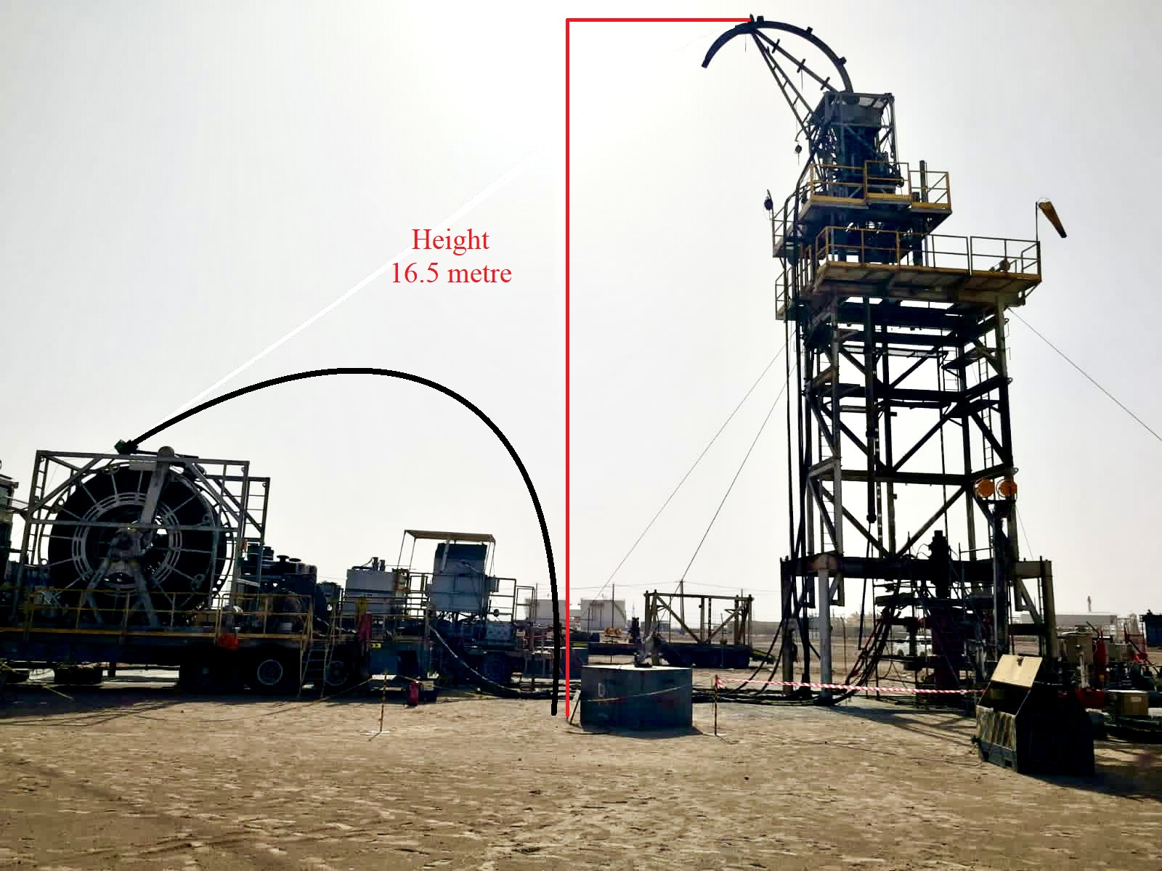
PDO Second Alert
Date:06/05/2022 Incident title: HiPo#33 Pattern: Dropped object . Potential severity: B4P
Target Audience: Coil Tubing Operators and CWI Supervisors.
What happened?
On 6th May 2022 at 22:16, during the 3rd milling run to mill off the TRSSV flapper, the circulation pressure started dropping, indicating that we were milling off. The pressure dropped from 4600psi to 3500psi at 3bpm. The operator tried to slack more weight on the mill to start milling again. When this happened, the pressure spiked, indicating that the motor had stalled. The operator Stopped pumping, picked up the coil off the bottom, and tried to mill again. At this time with a pump rate of 2.9 bbl/min and a circulation pressure of 3500 psi, we could not get any pressure increase to indicate any differential pressure across the motor. Tool Specialist contacted the Technical Manager of Through Tubing when there was no progress. multiple attempts were done to check if the motor was working. After two hours, it was decided to Pull out of hole to check the motor.
The operator continued to Pull out of hole to the surface when close to surface the operator reduced the speed to three meter per minutes and was trying to tag the stripper, at a depth of 2.25 meters on the injector depth, the reel started turning faster, and the end of the CT pipe came out of the gooseneck and fell to the ground.
Why it happened/Finding :
Coil Tubing pipe fatigue was with in the accepted limits.
Operation team called for technical support when there was no progress after the final motor stall
Coil tubing Pipe found parted ( up at top of slip inside the CT Connector)
Zero Well head Pressure reported at the time of incident
CTU crew performed three runs with same connector and visually inspected CT Connector prior each run
learning from this incident..
Always Ensure Coil tubing operator prior Coil on surface all contingency is reviewed, including potential parted pipe or lost BHA scenario is considered .
Ensure compliance to zone management all the time.
Coil Tubing Parted and fell on NO-GO Zone
Resulted No injury, No equipment's damage
Coil Tubing during normal operation
Ensure Prior Coil on surface all contingency is reviewed, including potential parted pipe or lost BHA scenario is considered .
Notes:
Ensure all dates and titles are input
A short description should be provided without mentioning names of contractors or individuals. You should include, what happened, to who (by job title) and what injuries this resulted in. Nothing more!
Four to five bullet points highlighting the main findings from the investigation. Remember the target audience is the front line staff so this should be written in simple terms in a way that everyone can understand.
The strap line should be the main point you want to get across
The images should be self explanatory, what went wrong (if you create a reconstruction please ensure you do not put people at risk) and below how it should be done.

Slide 2
Management self audit
Date:06/05/2022 Incident title: HiPo#33 Pattern: Drops Potential severity:B4P
As a learning from this incident and ensure continual improvement all contract managers must review their HSE risk management against the questions asked below
Confirm the following:
Do you always ensure key personal are following the zone management system?
Do you always ensure all SOP update and communicated ?
Does your management always ensure JSA and HEMP are updated and current?
Do you always ensure key personal are fully competent to handle and evaluate CT –contingencies ?
* If the answer is NO to any of the above questions please ensure you take action to correct this finding
Notes:
Ensure all dates and titles are input
Make a list of closed questions (only ‘yes’ or ‘no’ as an answer) to ask others if they have the same issues based on the management or HSE-MS failings or shortfalls identified in the investigation.
Imagine you have to audit other companies to see if they could have the same issues.
These questions should start with: Do you ensure…………………?

