Slide 1
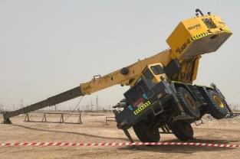
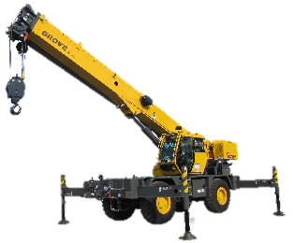
PDO Second Alert
Repeated Incident !
Date:16-Jul-23 Incident title:HIPO#34,Equipment/Asset Pattern: LOF/Drops Potential severity: C3P Activity: Crane Tipped over
Target Audience: Rigs & Hoist. Rig Manager, Subcontractors, Crane Operator, Maintenance Crew.
What happened?
Approximately at 08:20 am, the crane (GROVE, 4W-All Terrain 30T) was spotted outside of the location (approximately 16.3 meters away from the tea-room trailer) while the mechanic went to bring the grease gun. The Crane operator had extended the crane boom fully at approximately 30 degrees without extending the outriggers which led to weight imbalance and the crane tipped onto one side and rested with its top-end boom into ground level.
The Crane operator was able to exit the crane safely without any injuries.
Why it happened/Finding :
Inadequate work planning to perform crane maintenance work.
The crane operator did not extend the outriggers prior to operating the boom.
The area was neither designated nor prepared for the task.
The activities were performed without notifying the Rig Manager.
No meeting was carried out between the Crane Operator and Mechanic to discuss the correct steps to do the task.
Inadequate oversight of subcontractor's activities on site.
If it is repeated, Why is it repeated:
Activities were performed without the knowledge of the Rig Manager & engineering solutions were not considered in the learning from incident.
You're learning from this incident.
Rig Manager to ensure Musta’ed is effectively implemented in all activities including sub-contractors out of sight activities.
Crane Operator to extend the outriggers before operating the boom.
Rig Manager to ensure all third-party activities/tasks are to be discussed and approved prior to start even if it’s planned to perform outside of the location.
Rig Manager to ensure 3rd party maintenance crew have task-specific SOP prior to approving the task.
Ensure cranes are having Interlock system installed so that the crane boom can not be extended without extending the outriggers
Crane tipped over-outrigger not extended
Out rigger extended
Do not operate/extend Crane Boom without outriggers are fully extended.
Notes:
Ensure all dates and titles are input
A short description should be provided without mentioning names of contractors or individuals. You should include, what happened, to who (by job title) and what injuries this resulted in. Nothing more!
Four to five bullet points highlighting the main findings from the investigation. Remember the target audience is the front line staff so this should be written in simple terms in a way that everyone can understand.
The strap line should be the main point you want to get across
The images should be self explanatory, what went wrong (if you create a reconstruction please ensure you do not put people at risk) and below how it should be done.

Slide 2
Management self-audit
Repeated Incident !
Date:16-Jul-23 Incident title:HIPO#34,Equipment/Asset Pattern: LOF/Drops Potential severity: C3P Activity: Crane Tipped over
As a learning from this incident and ensure continual improvement all contract managers must review their HSE risk management against the questions asked below
Confirm the following:
Do your Cranes have Interlock system installed so that the crane boom can not be extended without extending the outriggers?
Do you have a system in place to ensure all sub-contractor activities onsite including maintenance are under your control of work?
Do you ensure the Crane operators meet the Competency requirements?
Have your Subcontractors onboarded with Musta’ed?
* If the answer is NO to any of the above questions, please ensure you take action to correct this finding
Notes:
Ensure all dates and titles are input
Make a list of closed questions (only ‘yes’ or ‘no’ as an answer) to ask others if they have the same issues based on the management or HSE-MS failings or shortfalls identified in the investigation.
Imagine you have to audit other companies to see if they could have the same issues.
These questions should start with: Do you ensure…………………?

