Slide 1
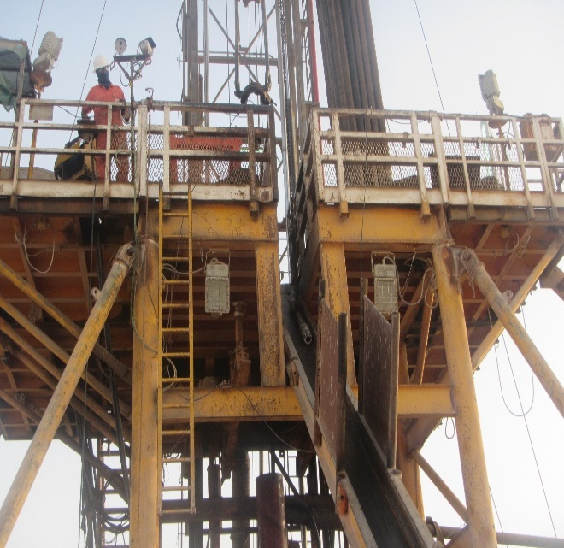
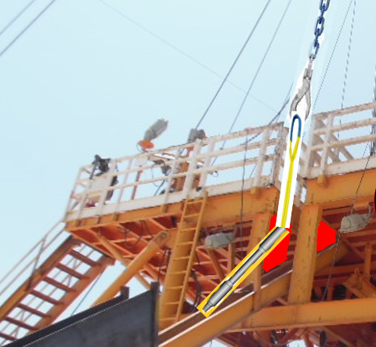
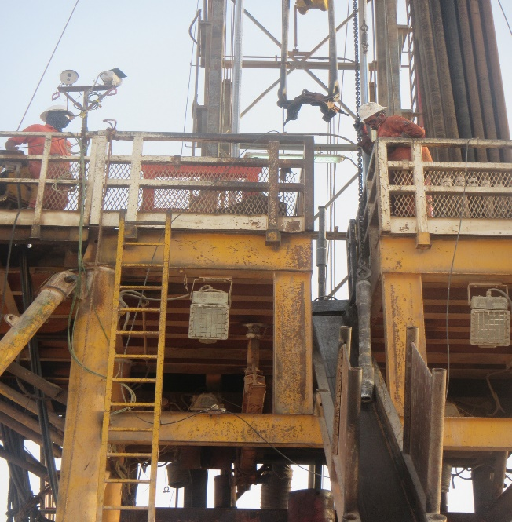
PDO Second Alert
Date: 16.06.2021 Incident Type: HiPo#34 Drops
What happened?
On 16th June 2021 at 1740 hrs, operations was picking up a 1.5m DP pup joint. While the Floorman was operating the hydraulic winch of the substructure and lifting the pup joint through the V-door, as the pup joint was about to cross the V-door to the rig floor, it swung and got caught underneath the substructure beam.
The Driller and another Floorman were on the rig floor. The Driller observed that the winch line chain was in high tension and immediately attempted to stop the winch operator but the wire rope sling parted at about 17m height above the rig floor (weight of the winch line ball is 6 kgs at 13m) and fell through the V-door with the chain linked on it while other end of the winch line came out from the crown sheave and landed on the rig floor. Nobody was hurt as the red zone was observed at the time of the incident.
Your learning from this incident..
Always ensure to stop the operation if you witness unsafe acts/conditions
Always ensure to discuss potential hazards and risks in detail during the pre-job meeting (JSA / TRIC / TBT)
Always ensure you do a proper planning for lifting and competent people are assigned to task.
Always ensure following correct procedure for de-rating lifting equipment (OEM approval)
Always ensure critical equipment inspections and certifications are properly done and the certificates reviewed prior to use of these equipment
Ensure crew hands are capturing design issues during the hazard hunts.
Open space where pup joint got caught
Ensure equipment is correctly used & lifting path is clear and free from obstacles
Notes:
Ensure all dates and titles are input
A short description should be provided without mentioning names of contractors or individuals. You should include, what happened, to who (by job title) and what injuries this resulted in. Nothing more!
Four to five bullet points highlighting the main findings from the investigation. Remember the target audience is the front line staff so this should be written in simple terms in a way that everyone can understand.
The strap line should be the main point you want to get across
The images should be self explanatory, what went wrong (if you create a reconstruction please ensure you do not put people at risk) and below how it should be done.

Slide 2
Management self-audit
Date: 16.06.2021 Incident Type: HiPo#34 Drops
As a learning from this incident and ensure continual improvement all contract
managers must review their HSE HEMP against the questions asked below
Confirm the following:
Do you ensure adequate risk assessment is conducted for critical activities?
Do you ensure dynamic DROPS are captured in your audit?
Do you ensure your team are empowered to intervene when required?
Do you ensure your team are competent to carry out the task
Do you have a procedure for winch line operations that is communicated and understood by relevant personnel?
Do you ensure competence of your inspection company?
Do you ensure your company is engaged in an Onsite Monitoring program?
* If the answer is NO to any of the above questions please ensure you take action to correct this finding.
Notes:
Ensure all dates and titles are input
Make a list of closed questions (only ‘yes’ or ‘no’ as an answer) to ask others if they have the same issues based on the management or HSE-MS failings or shortfalls identified in the investigation.
Imagine you have to audit other companies to see if they could have the same issues.
These questions should start with: Do you ensure…………………?

