Slide 1
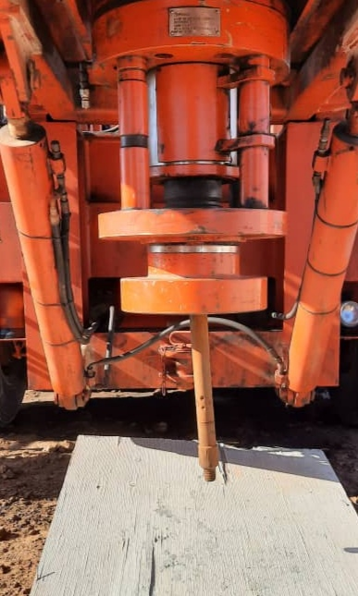
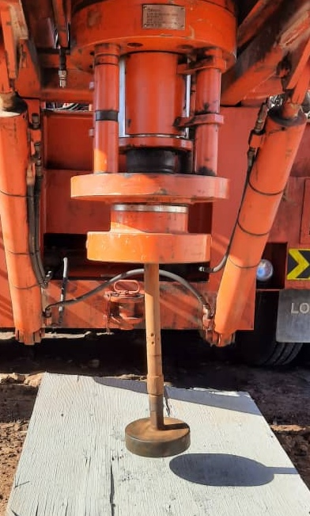
PDO Second Alert
Date:07/05/2022 Incident title: HiPo#34 Pattern: Drops Potential severity: C 4 (P)
What happened?
During rig down of CTU Injector and top section operations of unit CT-39 in order to allow Slickline to rig up, a miss communication from banksman to the CTU operator to stop pulling the coil out from the lubricator leading to fully ejecting of the coil from the injector and fall to the ground.
Why it happened/Finding :
The equipment set up didn’t consider the potential skid out and potential Slick Line Operation
The procedure of Rig up/ Rig down of injector head not followed by taking out the NoGo.
The crash frame was not requested for proper rig down of the injector head.
Supervisor was multitasking to accelerate the rig down.
STOP authority and intervention was not performed by crane operator.
If it is repeated, Why is it repeated:
Though the scenario led to the incident is different than the previous HiPo#77 in 2020; the outcome was the same. MOC was not triggered (Supervisor didn’t understand MOC is needed) to analyze the risks involved in removing the NoGo and to take the required permissions to pull the CT pipe inside the risers. This was a result of not following the implemented procedures.
Your learning from this incident..
Always review the design of service with DESC Engineer and Base Manager.
Always have NoGo at the end of the CT Pipe at all times.
Always trigger MOC if a deviation from the procedures is a must.
Always avoid doing multi tasking and focus on the in-hand task.
Conduct STOP and intervention drills regularly.
Always install a NoGo at the end of CT Pipe for Rig Up/ Rig down and during Coiled Tubing Operation.
Notes:
Ensure all dates and titles are input
A short description should be provided without mentioning names of contractors or individuals. You should include, what happened, to who (by job title) and what injuries this resulted in. Nothing more!
Four to five bullet points highlighting the main findings from the investigation. Remember the target audience is the front line staff so this should be written in simple terms in a way that everyone can understand.
The strap line should be the main point you want to get across
The images should be self explanatory, what went wrong (if you create a reconstruction please ensure you do not put people at risk) and below how it should be done.

Slide 2
Management self audit
Date:00/00/0000 Incident title: LTI#00, HVL#00, HiPo#00 Pattern: MVI, Drops and OHL. Potential severity: ……
As a learning from this incident and ensure continual improvement all contract managers must review their HSE risk management against the questions asked below
Confirm the following:
Do you ensure that the Design of Service and the required equipment are discussed with Base Manager and DESC engineer?
Do you ensure that the all requirements for the operation are available on location?
Do you ensure that all track stack sections are on location for the rig up?
Do you ensure that the Crash frame is on location?
Do you ensure that MOC is prepared if a deviation from the procedure is a must?
Do you ensure that the personnel on location are aware of all the lessons learnt from previous LFOs?
Do you ensure that the Zone management and signage is visible from all sides by all individuals?
* If the answer is NO to any of the above questions please ensure you take action to correct this finding
Notes:
Ensure all dates and titles are input
Make a list of closed questions (only ‘yes’ or ‘no’ as an answer) to ask others if they have the same issues based on the management or HSE-MS failings or shortfalls identified in the investigation.
Imagine you have to audit other companies to see if they could have the same issues.
These questions should start with: Do you ensure…………………?

