Slide 1
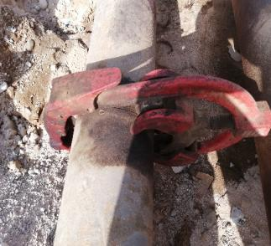
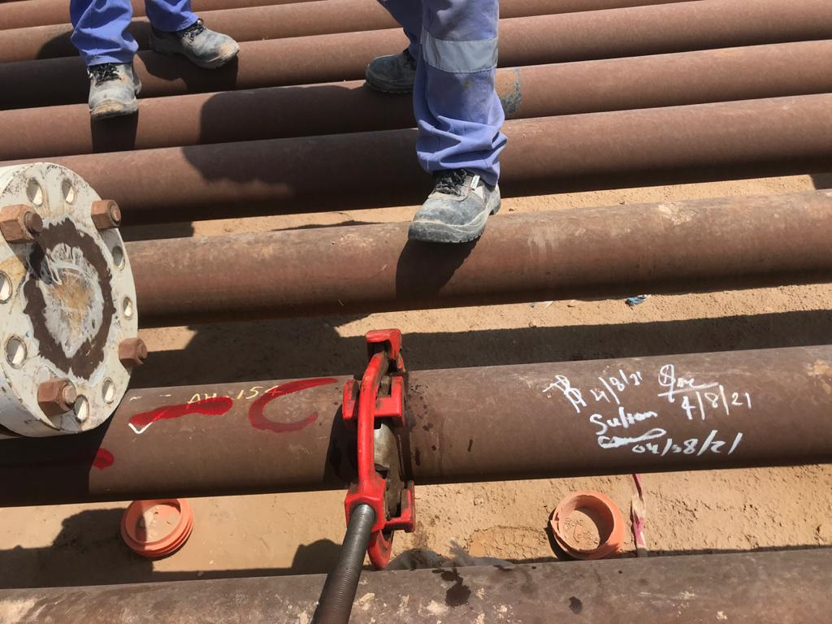
PDO Second Alert
Date: 27.06.2021 Incident Type: HiPo#36 cable cut
What happened?
As per the normal cold cutting practice, contractor crew who were assigned for re-routing existing flow lines, identified, line walked and marked ‘C” on a flowline at cut points using red paint. They also marked red “C” on adjacent Long Term Closed (LTC) flow line based on the verbal confirmation that it is hydrocarbon free. This was done to save time as this line was scheduled for cut on following day.
At the time of cold cut, additional red marking on the LTC line caused confusion resulting erroneous cutting of the wrong sequence line.
Your learning from this incident.
Always verify identification of the lines before cold cut.
Always seek clarification in case the procedures are not clear.
Always follow reliable identification methods like hammering, pigging.
Sign off flowline by all concerned – Area Authority, Permit Applicant &
Holder.
Never take short cuts.
Never allow the Permit holder to physically involve in carrying out activities.
Shortcuts Cut Life Short
Sign off on flow line by AA & PH before cold cut
Notes:
Ensure all dates and titles are input
A short description should be provided without mentioning names of contractors or individuals. You should include, what happened, to who (by job title) and what injuries this resulted in. Nothing more!
Four to five bullet points highlighting the main findings from the investigation. Remember the target audience is the front line staff so this should be written in simple terms in a way that everyone can understand.
The strap line should be the main point you want to get across
The images should be self explanatory, what went wrong (if you create a reconstruction please ensure you do not put people at risk) and below how it should be done.

Slide 2
Management self audit
Date: 27.06.2021 Incident Type: HiPo#36 cable cut
As a learning from this incident and ensure continual improvement all contract
managers must review their HSE HEMP against the questions asked below
Confirm the following:
What are the methods you adopt to eliminate errors in identification of flowlines during normal and complicated environment?
How do you apply learning from past incidents to prevent potential dangerous occurrences?
Do you have an authorization process prior to cutting activity to ensure clear identification of the lines?
Have you ensure employees at site comply with the procedure?
Have you ensure adequate supervision available for the task?
* If the answer is NO to any of the above questions please ensure you take action to correct this finding.
Notes:
Ensure all dates and titles are input
Make a list of closed questions (only ‘yes’ or ‘no’ as an answer) to ask others if they have the same issues based on the management or HSE-MS failings or shortfalls identified in the investigation.
Imagine you have to audit other companies to see if they could have the same issues.
These questions should start with: Do you ensure…………………?

