Slide 1
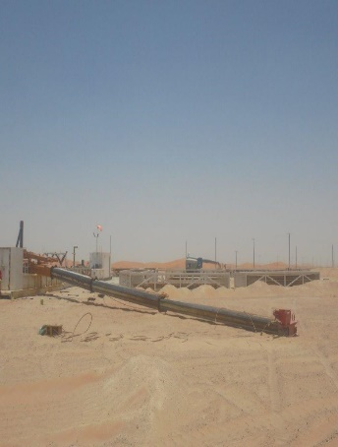
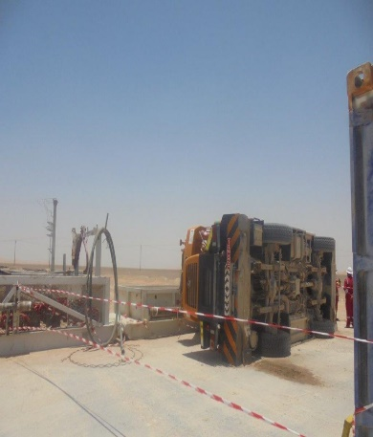
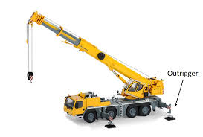
PDO Second Alert
Date:30/05/2022 Incident title: Crane tipped over Pattern: Drops& Lifting Potential severity: C4P
Target Audience: C-Operators, F-Operators, Asst. Driller, Roustabout Foreman,
What happened?
On 30th May at around 7:30 PM, After crane operators crew change, the night crane operator carried out pre-shift daily crane inspection which was stationed at parking area. He observed wire overlapped on wire drum. He decided to reeve the wire line in correct position. In this process he called night forklift operator to help him observe the drum and gave verbal signal. During the reeving process, he extended the boom without extracting the outriggers. Once wire was back in place, he tried to retract the boom which was unsuccessful. After several attempts, he asked night forklift operator to report the case to the tool pusher. Day crane operator (IP) was called to analyze the situation. Once IP reached the site. TP asked him to carefully just do visual inspection. However, IP entered cabin and decided to start the engine in his own judgment. The crane started to swing by itself and shifted the load on left hand side, which led the crane toppling to the left side.
During this time, IP remained inside the crane’s cabin. After the impact, he was helped to leave the cabin and sent to hospital for further medical examination.
Why it happened/Finding :
Incompetent crane operator operated the crane
The boom was extracted without open the outriggers due to technical reasons . This led the crane to become unbalance and toppled to ground due to computer malfunctions.
Crane wire overlapped at the end roll, that’s why the crane operator had to extend the boom up to 19 meters to reach overlap point and free the wire.
There was no intervention from forklift operator when he saw crane boom was taking out without open the outriggers.
crane operator failed to follow operation manual
Your learning from this incident..
Ensure the crane outriggers and its jacks are fully opened before extract the boom at any case.
Always follow operation manual
Always intervene whenever applicable to prevent unwanted events from occur.
Always STOP, re-assess the situation and never take individual decision.
Ensure to report any defect to the concern maintenance team and DO NOT attempt to carry the repairing job by yourself .
Crane tipped over
Always use outrigger prior extend boom
Always extend outriggers / stabilizers before crane operations
Notes:
Ensure all dates and titles are input
A short description should be provided without mentioning names of contractors or individuals. You should include, what happened, to who (by job title) and what injuries this resulted in. Nothing more!
Four to five bullet points highlighting the main findings from the investigation. Remember the target audience is the front line staff so this should be written in simple terms in a way that everyone can understand.
The strap line should be the main point you want to get across
The images should be self explanatory, what went wrong (if you create a reconstruction please ensure you do not put people at risk) and below how it should be done.

Slide 2
Management self audit
Date:30/05/2022 Incident title: Crane tipped over Pattern: Drops & Lifting Potential severity: C4P
As a learning from this incident and ensure continual improvement all contract managers must review their HSE risk management against the questions asked below
Confirm the following:
Do you ensure your sub-contractor has an effective competency verification process for the crane operators ?
Do you ensure your sub-contractor are effectively implementing OPAL/PDO requirements for cranes operators?
Do you ensure the effectiveness and quality of the crane maintenance / inspections process covering the computer functionality/ software?
* If the answer is NO to any of the above questions please ensure you take action to correct this finding
Notes:
Ensure all dates and titles are input
Make a list of closed questions (only ‘yes’ or ‘no’ as an answer) to ask others if they have the same issues based on the management or HSE-MS failings or shortfalls identified in the investigation.
Imagine you have to audit other companies to see if they could have the same issues.
These questions should start with: Do you ensure…………………?

