Slide 1
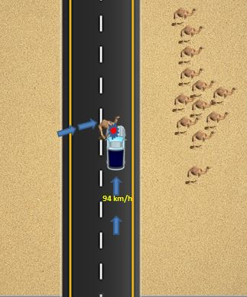
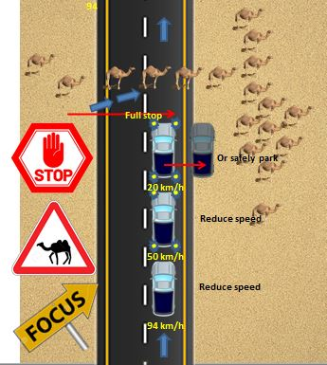
PDO Second Alert
Date: 29.06.2021 Incident Type: HiPo#37- MVI
What happened?
Driver (FSE) attended a repair job at ZAZ-16 with standalone team. The job was completed by noon. At 12:43 driver was driving from Harweel to Nimr. At 13:45 before reaching Marmul, he saw a group of camels on the right hand side of the road (outside the road). A camel from the left side of the road, suddenly crossed to join the group and hit the front left side of vehicle. The driver was unhurt.
The camel died on the spot.
Your learning from this incident..
Drive defensively and ensure to take extra precaution when animals are sighted at a distance.
Always slow down and move out of the way in lower speed or stop to avoid hitting camels and any animals crossing the roads.
Ensure the road is clear of any hazards before returning back to normal driving speed.
To always stay focus and pay attention when driving a vehicle at all times.
Ensure that animal/camel crossing is included in all TBTs.
Stay focus while driving, look out for movement of animals alongside the road. Remember, when you see one or a group, there may be others nearby.
Notes:
Ensure all dates and titles are input
A short description should be provided without mentioning names of contractors or individuals. You should include, what happened, to who (by job title) and what injuries this resulted in. Nothing more!
Four to five bullet points highlighting the main findings from the investigation. Remember the target audience is the front line staff so this should be written in simple terms in a way that everyone can understand.
The strap line should be the main point you want to get across
The images should be self explanatory, what went wrong (if you create a reconstruction please ensure you do not put people at risk) and below how it should be done.

Slide 2
Management self audit
Date: 29.06.2021 Incident Type: HiPo#37- MVI
As a learning from this incident and ensure continual improvement all contract
managers must review their HSE HEMP against the questions asked below
Confirm the following:
Do you ensure that camels or other animals on the road is part of your discussion during safety meetings?
Do you ensure that all hazards and risk mitigations during driving activities are communicated on the issuance of Journey Plan?
Do you ensure that your driving safety procedure and HEMP covers animal crossing hazards?
Do you ensure all the vehicles comply with SP-2000 requirements and all documentations are up to date?
Do you ensure that all lateral learning are cascaded to all the members of the organization?
* If the answer is NO to any of the above questions please ensure you take action to correct this finding.
Notes:
Ensure all dates and titles are input
Make a list of closed questions (only ‘yes’ or ‘no’ as an answer) to ask others if they have the same issues based on the management or HSE-MS failings or shortfalls identified in the investigation.
Imagine you have to audit other companies to see if they could have the same issues.
These questions should start with: Do you ensure…………………?

