Slide 1
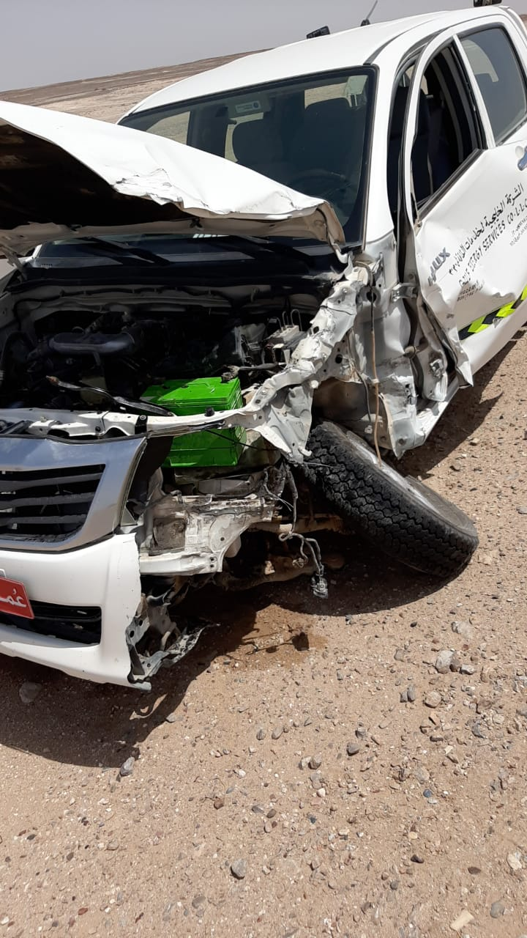
PDO Second Alert
Date:01/06/2022 Incident title: HiPo #39 Pattern: MVI Potential severity: C4P
Target Audience: Drivers
What happened?
On 1st June 2022 at 10:06 am, light vehicle driver was traveling from Nizwa base to Burhan (167 km ARA Rig-1) using government blacktop road. While reaching Zahiya, he collided with a rear structure of a moving cement mixer truck moving on the same direction. Incident resulted in damage to the light vehicle, minor damage to the truck and no injury to driver after assessment from medical team
Why it happened/Finding :
Driver was distracted by micro sleep or other factors
Driver’s BMI was higher than 30 where sleep apnea was not conducted
Driver failed to stay alerted while driving
Driver failed to scan the road while driving
Driver failed to keep safe distance with front moving truck
Driver failed to follow defensive driving techniques
Your learning from this incident..
Ensure sleep apnea is performed for any BMI higher than 30
Always follow defensive driving techniques
Eliminate any distraction factor while driving
Always scan the road while driving to identify any hazards
Never get distracted while Driving
Notes:
Ensure all dates and titles are input
A short description should be provided without mentioning names of contractors or individuals. You should include, what happened, to who (by job title) and what injuries this resulted in. Nothing more!
Four to five bullet points highlighting the main findings from the investigation. Remember the target audience is the front line staff so this should be written in simple terms in a way that everyone can understand.
The strap line should be the main point you want to get across
The images should be self explanatory, what went wrong (if you create a reconstruction please ensure you do not put people at risk) and below how it should be done.

Slide 2
Management self audit
Date:01/06/2022 Incident title: HiPo #39 Pattern: MVI, Potential severity: C4P
As a learning from this incident and ensure continual improvement all contract managers must review their HSE risk management against the questions asked below
Confirm the following:
Do you ensure Drivers apply defensive driving techniques during the trip?
Do you ensure your process verify the compliance requirement with SP-1230?
Do you ensure drivers with BMI above 30 go through sleep apnea study?
Do you ensure drivers keep safe distance with front moving vehicles?
Do you ensure drivers stay alerted during the trip and never get distracted?
* If the answer is NO to any of the above questions please ensure you take action to correct this finding
Notes:
Ensure all dates and titles are input
Make a list of closed questions (only ‘yes’ or ‘no’ as an answer) to ask others if they have the same issues based on the management or HSE-MS failings or shortfalls identified in the investigation.
Imagine you have to audit other companies to see if they could have the same issues.
These questions should start with: Do you ensure…………………?

